Slide 1
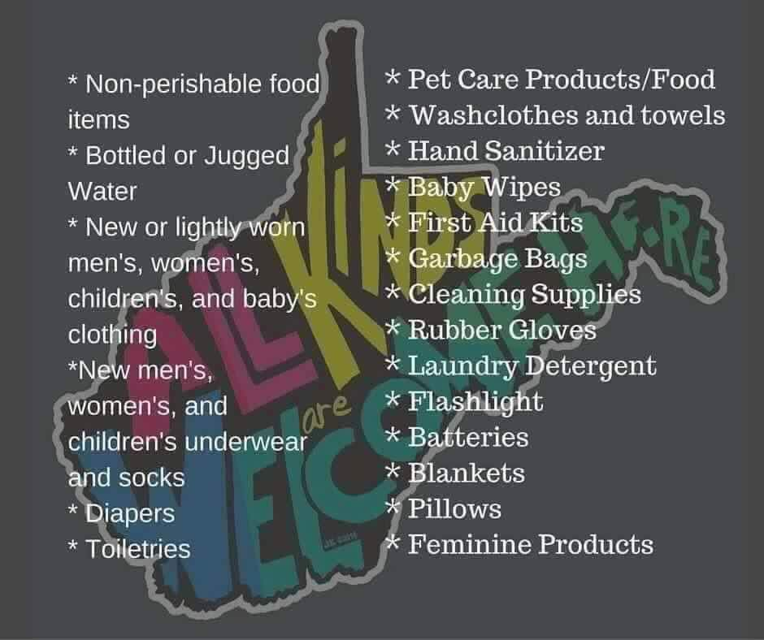

Slide 2
Numbers
A Book Of Pilgrimage

Slide 3
Numbers: The Pilgrimage
Named from the 2 Numberings of Israel in the wilderness (1:2, 26:2)
Records the wilderness experience of God’s people
Covers a period about 38 years
1st day of the 2nd month in the 2nd year number the people (1:1)
The 20th day of the 2nd month they leave Sinai for promised land (10:11)
Deuteronomy opens with a reference to the 1st day of the 11th month of the 40th year (1:3)

Slide 4
Comparison Of Books
Leviticus
Numbers
Believer’s worship
Believer’s purity
Believer’s position
Ceremonial
Faithfulness to God
Believer’s walk
Believer’s pilgrimage
Believer’s progress
Historical
Fellowship with God

Slide 5
Numbers: The Pilgrimage
Key Verses
(Num 1:1) And the LORD spake unto Moses in the wilderness of Sinai, in the tabernacle of the congregation….
(Num 32:23) But if ye will not do so, behold, ye have sinned against the LORD: and be sure your sin will find you out.

Slide 6
Messianic Prophecy
Crucifixion
(Num 9:12) They shall leave none of it unto the morning, nor break any bone of it: according to all the ordinances of the passover they shall keep it.
(Joh 19:36) For these things were done, that the scripture should be fulfilled, A bone of him shall not be broken.

Slide 7
Typology in Numbers
The daily manna
(Num 11:7) And the manna was as coriander seed, and the colour thereof as the colour of bdellium.
(Joh 6:32) Then Jesus said unto them, Verily, verily, I say unto you, Moses gave you not that bread from heaven; but my Father giveth you the true bread from heaven.

Slide 8
Typology in Numbers
Aarons rod - a picture of the resurrection ordaining the high priest
(Num 17:2) Speak unto the children of Israel, and take of every one of them a rod according to the house of their fathers, of all their princes according to the house of their fathers twelve rods: write thou every man's name upon his rod.
(Heb 4:14) Seeing then that we have a great high priest, that is passed into the heavens, Jesus the Son of God, let us hold fast our profession.

Slide 9
Typology in Numbers
Leprosy forbidden – church discipline
(Num 5:2) Command the children of Israel, that they put out of the camp every leper, and every one that hath an issue, and whosoever is defiled by the dead:
(1Co 5:11) But now I have written unto you not to keep company, if any man that is called a brother be a fornicator, or covetous, or an idolater, or a railer, or a drunkard, or an extortioner; with such an one no not to eat.

Slide 10
Geographical Movements
Three Main Geographical Movements
From Sinai to Kadesh-barnea (1-12)
From Kadesh-barnea through Wilderness and back (13-19)
From Kadesh-barnea to Jordan (20-36)

Slide 11
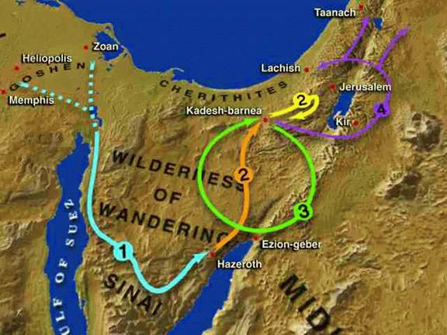

Slide 12
Outline
Two main Sections
Israel in the wilderness: The Old Generation
Israel on The Way: The New Generation

Slide 13
Outline
Israel in the wilderness: The old Generation (1:1-19:22)
Discipline in the Wilderness (1:1-9:14)
Direction in the Wilderness (9:15-10:36)
Discontent in the Wilderness (11:1-13:33)
Death in the Wilderness (14:1-16:50)

Slide 14
A. Discipline in the Wilderness (1:1-9:14)
The people counted (1:1-1:54)
Fighting men age 20 and up we counted
603,550 = 2-4 million people
The people camped (2:1-4:49)
God assigned different jobs to the Levites
Kohathites carried the furniture
Each tribe were assigned a location
The tabernacle was the center of everything

Slide 15
(Num 2:2) Every man of the children of Israel shall pitch by his own standard, with the ensign of their father's house: far off about the tabernacle of the congregation shall they pitch.

Slide 16
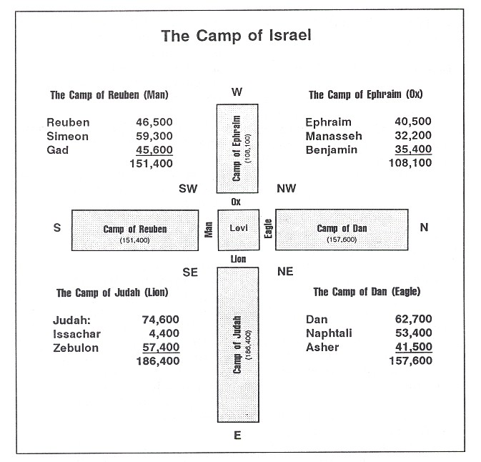

Slide 17
A. Discipline in the Wilderness (1:1-9:14)
The people cleansed (5:1-31)
We learn the laws regarding leprosy
Always a picture of sin
Gehazi and King Uzziah example of discipline for sin
Only 3 lepers were cleansed in Old Testament
Moses, Miriam, Naaman
The people consecrated (6:1-9:14)
We learn about the Nazarite Vow
Samuel, Samson, and John the Baptist lived life-long vow

Slide 18
B. Direction in the Wilderness (9:15-10:36)
(Num 9:15) And on the day that the tabernacle was reared up the cloud covered the tabernacle, namely, the tent of the testimony: and at even there was upon the tabernacle as it were the appearance of fire, until the morning.
(Num 9:16) So it was alway: the cloud covered it by day, and the appearance of fire by night.
(Num 9:17) And when the cloud was taken up from the tabernacle, then after that the children of Israel journeyed: and in the place where the cloud abode, there the children of Israel pitched their tents.

Slide 19
B. Direction in the Wilderness (9:15-10:36)
Instrument of this direction
Shekinah Glory Cloud –fiery, cloudy pillar
Rested on mercy seat and overshadowed camp
Guided Israel through wilderness
Influence of this direction
Conscious – They knew where God wanted them
Conspicuous – Could make no mistake
Continuous – Guided every step of the way
Did not mean that way was easy

Slide 20
C. Discontent in the Wilderness (11:1-13:33)
(Num 11:1) And when the people complained, it displeased the LORD: and the LORD heard it; and his anger was kindled; and the fire of the LORD burnt among them, and consumed them that were in the uttermost parts of the camp.
(Num 11:2) And the people cried unto Moses; and when Moses prayed unto the LORD, the fire was quenched.

Slide 21
C. Discontent in the Wilderness (11:1-13:33)
“The book of murmurings”
From the time God saved them they complained
Criticized manna, gifts of prophecy, Moses for his marriage, and the Promised Land
Kadesh-barnea
“Trusted God to deliver from Egypt but not to deliver into Canaan”
“Many believers' trust God to Save them from the penalty of sin but fail to believe God can save them from the power of sin”

Slide 22
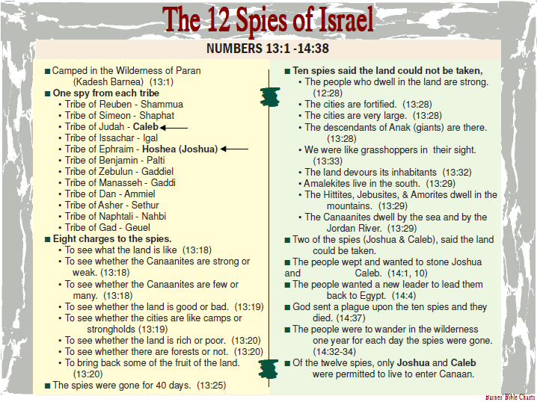

Slide 23
D. Death in the Wilderness (14:1-16:50)
Death in Prayer – Ch. 14
(Num 14:2) And all the children of Israel murmured against Moses and against Aaron: and the whole congregation said unto them, Would God that we had died in the land of Egypt! or would God we had died in this wilderness!
(Num 14:29) Your carcases shall fall in this wilderness; and all that were numbered of you, according to your whole number, from twenty years old and upward, which have murmured against me,

Slide 24
D. Death in the Wilderness (14:1-16:50)
Death in Pride – Ch. 16
(Num 16:1) Now Korah, the son of Izhar, the son of Kohath, the son of Levi, and Dathan and Abiram, the sons of Eliab, and On, the son of Peleth, sons of Reuben, took men:
(Num 16:2) And they rose up before Moses, with certain of the children of Israel, two hundred and fifty princes of the assembly, famous in the congregation, men of renown:

Slide 25
D. Death in the Wilderness (14:1-16:50)
Death in Pride – Ch. 16
(Num 16:3) And they gathered themselves together against Moses and against Aaron, and said unto them, Ye take too much upon you, seeing all the congregation are holy, every one of them, and the LORD is among them: wherefore then lift ye up yourselves above the congregation of the LORD?
Korah was leading a rebellion against God’s leadership
The Earth opened up and swallowed them all
“God solemnly taught His people that it is a serious thing to challenge God-ordained leaders”

Slide 26
Outline
Israel on the way: The New Generation (20:1-36:13)
Recalling the Past (20:1-29)
Reviewing the Future (27:12-36:13)

Slide 27
A. Recalling the Past (20:1-29)
We now come to the 2nd numbering
This is a complete and new generation
They are getting ready to inherit the promised land
There is a 37 gap between Ch.19 and 20
Moses recalls the memories of His past
He buries his sister in the desert of Zin
He recalls the methods of the past
They are thirsty again and God tells him to speak to the rock but he strikes it – disobedience

Slide 28
B. Reviewing the Future (27:12-36:13)
“three major emphasis are found in this closing section”
The leadership of Israel (Ch. 27)
(Num 27:12) And the LORD said unto Moses, Get thee up into this mount Abarim, and see the land which I have given unto the children of Israel.
(Num 27:13) And when thou hast seen it, thou also shalt be gathered unto thy people, as Aaron thy brother was gathered.
(Num 27:14) For ye rebelled against my commandment in the desert of Zin, in the strife of the congregation, to sanctify me at the water before their eyes: that is the water of Meribah in Kadesh in the wilderness of Zin.

Slide 29
B. Reviewing the Future (27:12-36:13)
(Num 27:15) And Moses spake unto the LORD, saying,
(Num 27:16) Let the LORD, the God of the spirits of all flesh, set a man over the congregation,
(Num 27:17) Which may go out before them, and which may go in before them, and which may lead them out, and which may bring them in; that the congregation of the LORD be not as sheep which have no shepherd.
And God made Joshua the leader of Israel

Slide 30
B. Reviewing the Future (27:12-36:13)
The Laws of Israel (Ch. 28-30)
Moses reviews the Levitical offerings and the annual celebrations that they were to continue to keep even after they enter Canaan land
The Land of Israel (Ch. 31-36)
The land was separated out to each of the tribes with the Levites dispersed among them
The tribes of Rueben and Gad wanted to stay on the wilderness side of the Jordan

Slide 31
B. Reviewing the Future (27:12-36:13)
The saw it was good for their cattle and they made a fleshly decision
“their choice was world-bordering, and they were the first tribes to be carried away in the days of the Assyrians. It never pays to see how close we can get to the world. We need to get over Jordan.”
How many Christians get saved but then want to live as close to the world as possible

Slide 32
B. Reviewing the Future (27:12-36:13)
“one phrase that sums it all up: trust and obey”
Many Christians will wander in the wilderness their entire Christian life and never reach the promised land
They choose to live close to the world
And the will continually struggle with sin and life
And they will not trust and obey
They will live with a lack of faith and unbelief that will completely stop any forward movement

