Slide 1
Genesis
In The Beginning: A Book of First

Slide 2
In The Beginning
(Gen 1:1) In the beginning God created the heaven and the earth.
Def. - Origin, source, generation, beginning
God is mentioned by name 32 time in 31 verses (Gen.1)
Author – Moses

Slide 3
In The Beginning
To Whom – Isreal
When written – Too much dispute
Main Characters – Adam, Eve, Cain, Abel, Enoch, Esau, Jacob (Isreal), Abraham, Isaac, Joseph
Bible covers 4,100 yrs. (c.)
Genesis covers 2,200 yrs. (c.)

Slide 4
In The Beginning
The beginning of almost everything
Universe, life, man, marriage, sin, death, family, redemption, prophecy, language, sacrifice
Genesis in 8 words-
Creation, fall, flood, Babel, Abraham, Isaac, Jacob, Joseph

Slide 5
Messianic Prophecy
Messiah would be a descendant of the following men
Shem – Genesis 9:26
Abraham – Genesis 12:3, 22:18
Isaac – Genesis 17:19, 21:12, 26:4
Jacob – Genesis 28:14
Judah – Genesis 49:10

Slide 6
Messianic Prophecy
(Gen 22:18) And in thy seed shall all the nations of the earth be blessed; because thou hast obeyed my voice.
Messiah from the lineage of Abraham
Messiah would be the redeemer of all nations

Slide 7
Covenants God Made with Man
Edenic Covenant – Conditional (Gen. 1:26-31, 2:16-17)
Adamic covenant – Unconditional (Gen. 3:14-19)
Noahic Covenant – Unconditional (Gen. 8:20-9:27)
Abrahamic Covenant – Unconditional (Gen. 12:1-4,13:14-17,15:1-7,17:1-5)

Slide 8
Complete Outline
Primeval History: The Beginning of the Human Race (1:1-11:32)
The Creation, Curse, Catastrophe, Coalition
Patriarchal History: The Beginning of the Hebrew Race (12:1-50:26)
The Progenitor (first father), Pilgrim, Propagator (multiply), Provider

Slide 9
I. Primeval History (1:1-11:32) Beginning of the Human Race
Primeval - Of or resembling the earliest ages in the history of the world
The Creation (1:1-2:25)
The Curse (3:1-4:15)
The Catastrophe (4:16-9:29)
The Coalition (10:1-11:32)

Slide 10
I. Primeval History (1:1-11:32) Beginning of the Human Race
A. The Creation (1:1-2:25)
“And God said” 10 times
1st set of commandments
“After its kind” 10 times
A peculiar order to creation
Two matching phases

Slide 11
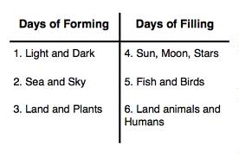
I. Primeval History (1:1-11:32) Beginning of the Human Race

Slide 12
I. Primeval History (1:1-11:32) Beginning of the Human Race
The Curse (3:1-4:15)
Nature of the Sin
Eve – deceived
Adam – Disobedient
Results of the Fall
Sin, sorrow, suffering, and death
Imputed sin – Romans 5:12

Slide 13
I. Primeval History (1:1-11:32) Beginning of the Human Race
The Curse (3:1-4:15)
(Rom 5:12) Wherefore, as by one man sin entered into the world, and death by sin; and so death passed upon all men, for that all have sinned:

Slide 14
I. Primeval History (1:1-11:32) Beginning of the Human Race
The Catastrophe (4:16-9:29)
Genesis 4 list the descendants of Cain
Genesis 5 list the descendants of Seth
Genesis 6 the world is evil

Slide 15
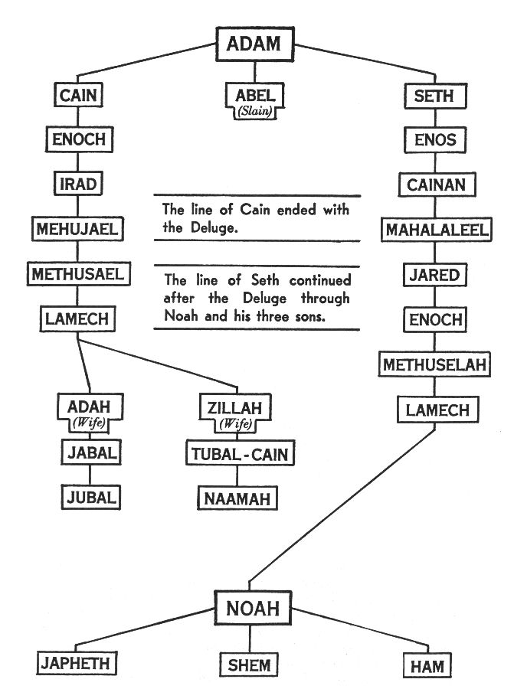

Slide 16
I. Primeval History (1:1-11:32) Beginning of the Human Race
The Catastrophe (4:16-9:29)
(Gen 6:5) And GOD saw that the wickedness of man was great in the earth, and that every imagination of the thoughts of his heart was only evil continually.
(Gen 6:6) And it repented the LORD that he had made man on the earth, and it grieved him at his heart.

Slide 17
I. Primeval History (1:1-11:32) Beginning of the Human Race
The Catastrophe (4:16-9:29)
(Gen 6:7) And the LORD said, I will destroy man whom I have created from the face of the earth; both man, and beast, and the creeping thing, and the fowls of the air; for it repenteth me that I have made them.
(Gen 6:8) But Noah found grace in the eyes of the LORD.

Slide 18
I. Primeval History (1:1-11:32) Beginning of the Human Race
The Coalition (10:1-11:32)
Noah comes from the line of Seth
Ham, Shem, and Japheth
Ham is unblessed by Noah for his personal indecency and impropriety

Slide 19
I. Primeval History (1:1-11:32) Beginning of the Human Race
(Gen 9:21) And he drank of the wine, and was drunken; and he was uncovered within his tent.
(Gen 9:22) And Ham, the father of Canaan, saw the nakedness of his father, and told his two brethren without.

Slide 20
I. Primeval History (1:1-11:32) Beginning of the Human Race
(Gen 9:23) And Shem and Japheth took a garment, and laid it upon both their shoulders, and went backward, and covered the nakedness of their father; and their faces were backward, and they saw not their father's nakedness.

Slide 21
I. Primeval History (1:1-11:32) Beginning of the Human Race
(Gen 9:24) And Noah awoke from his wine, and knew what his younger son had done unto him.
(Gen 9:25) And he said, Cursed be Canaan; a servant of servants shall he be unto his brethren.

Slide 22
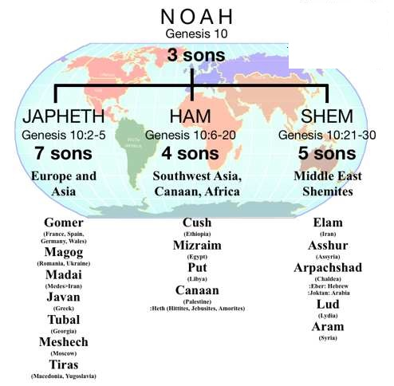
I. Primeval History (1:1-11:32) Beginning of the Human Race

Slide 23
I. Primeval History (1:1-11:32) Beginning of the Human Race
The Coalition (10:1-11:32)
Nimrod builds the tower of Babel in defiance to God.
He wanted a world federation of nations, one speech, one religion
God scattered them abroad and confounded their speech

Slide 24
II. Patriarchal History (12:1-50:26) Beginning of the Hebrew Race
Patriarch - a person regarded as the father or founder of an order, class, etc.
The Progenitor: Abraham (12:1-25:11)
The Pilgrim: Isaac (25:19-27:46)
The Propagator: Jacob (28:1-35:29)
The Provider: Joseph (36:1-47:26)

Slide 25
II. Patriarchal History (12:1-50:26) Beginning of the Hebrew Race
The Progenitor:Abraham (12:1-25:11)
Abraham was called out of the Ur of Chaldeas
He was a stranger in the land of Canaan
The Abrahamic Covenant (unconditional)

Slide 26
II. Patriarchal History (12:1-50:26) Beginning of the Hebrew Race
The Progenitor:Abraham (12:1-25:11)
(Gen 12:1) Now the LORD had said unto Abram, Get thee out of thy country, and from thy kindred, and from thy father's house, unto a land that I will shew thee:
(Gen 12:2) And I will make of thee a great nation, and I will bless thee, and make thy name great; and thou shalt be a blessing:

Slide 27
II. Patriarchal History (12:1-50:26) Beginning of the Hebrew Race
The Progenitor:Abraham (12:1-25:11)
Abraham’s two sons
Isaac and Ishmael
Ishmael – son of the maid servant
A product of unbelief
Isaac – son of promise

Slide 28
Genesis
In The Beginning: A Book of First

Slide 29
1st Mention of Satan (Gen. 31:1-5)
(Gen 3:1) Now the serpent was more subtil than any beast of the field which the LORD God had made. And he said unto the woman, Yea, hath God said, Ye shall not eat of every tree of the garden?
(Gen 3:2) And the woman said unto the serpent, We may eat of the fruit of the trees of the garden:

Slide 30
1st Mention of Satan (Gen. 31:1-5)
(Gen 3:3) But of the fruit of the tree which is in the midst of the garden, God hath said, Ye shall not eat of it, neither shall ye touch it, lest ye die.
(Gen 3:4) And the serpent said unto the woman, Ye shall not surely die:
(Gen 3:5) For God doth know that in the day ye eat thereof, then your eyes shall be opened, and ye shall be as gods, knowing good and evil.

Slide 31
1st Mention of Sin (Gen. 31:6-13)
(Gen 3:6) And when the woman saw that the tree was good for food, and that it was pleasant to the eyes, and a tree to be desired to make one wise, she took of the fruit thereof, and did eat, and gave also unto her husband with her; and he did eat.
(Gen 3:7) And the eyes of them both were opened, and they knew that they were naked; and they sewed fig leaves together, and made themselves aprons.

Slide 32
1st Mention of Sin (Gen. 31:6-13)
(Gen 3:8) And they heard the voice of the LORD God walking in the garden in the cool of the day: and Adam and his wife hid themselves from the presence of the LORD God amongst the trees of the garden.
(Gen 3:9) And the LORD God called unto Adam, and said unto him, Where art thou?
(Gen 3:10) And he said, I heard thy voice in the garden, and I was afraid, because I was naked; and I hid myself.

Slide 33
1st Mention of Sin (Gen. 31:6-13)
(Gen 3:11) And he said, Who told thee that thou wast naked? Hast thou eaten of the tree, whereof I commanded thee that thou shouldest not eat?
(Gen 3:12) And the man said, The woman whom thou gavest to be with me, she gave me of the tree, and I did eat.
(Gen 3:13) And the LORD God said unto the woman, What is this that thou hast done? And the woman said, The serpent beguiled me, and I did eat.

Slide 34
1st Mention of a Savior (Gen. 31:14-15)
(Gen 3:14) And the LORD God said unto the serpent, Because thou hast done this, thou art cursed above all cattle, and above every beast of the field; upon thy belly shalt thou go, and dust shalt thou eat all the days of thy life:
(Gen 3:15) And I will put enmity between thee and the woman, and between thy seed and her seed; it shall bruise thy head, and thou shalt bruise his heel.

