Slide 1
The Tabernacle
Understanding our New Testament better by knowing the Old Testament

Slide 2
Gods Prescribed Way of Worship
(Exo 25:8) And let them make me a sanctuary; that I may dwell among them.
(Exo 29:45) And I will dwell among the children of Israel, and will be their God.
(Exo 29:46) And they shall know that I am the LORD their God, that brought them forth out of the land of Egypt, that I may dwell among them: I am the LORD their God.

Slide 3
A Projection of Gods Redemptive Plan
(Joh 1:14) And the Word was made flesh, and dwelt among us, (and we beheld his glory, the glory as of the only begotten of the Father,) full of grace and truth.
The tabernacle was Gods way of meeting with his people. They could find forgiveness and fellowship with God in the tabernacle, exactly what we find in Jesus Christ through salvation.

Slide 4
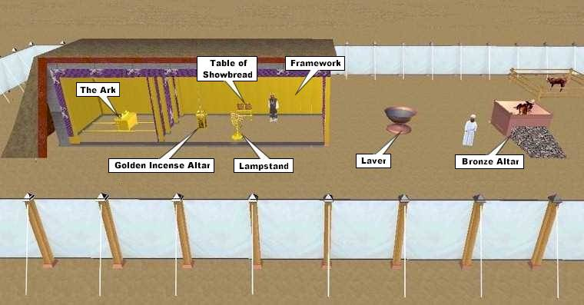
Basic Layout of the Tabernacle

Slide 5
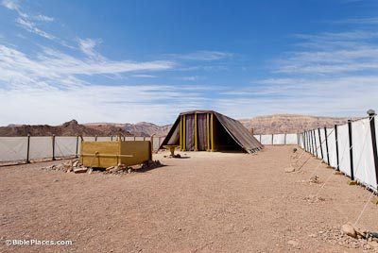
Life Size Replica at Timna park

Slide 6
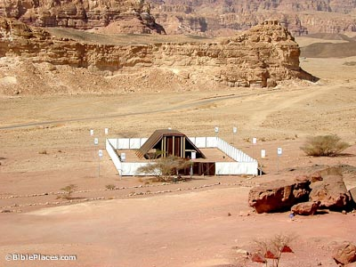
Life Size Replica at Timna Park

Slide 7
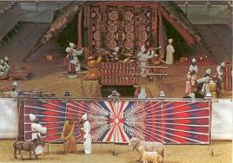
The Gate

Slide 8
New Testament Scripture
(Joh 14:6) Jesus saith unto him, I am the way, the truth, and the life: no man cometh unto the Father, but by me.
(Joh 10:9) I am the door: by me if any man enter in, he shall be saved, and shall go in and out, and find pasture.
(Mat 7:13) Enter ye in at the strait gate: for wide is the gate, and broad is the way, that leadeth to destruction, and many there be which go in thereat:
(Mat 7:14) Because strait is the gate, and narrow is the way, which leadeth unto life, and few there be that find it.

Slide 9
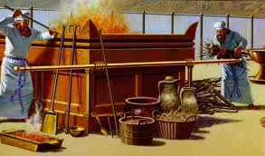
The Brazen Altar

Slide 10
Old and New Testament Scripture
(Lev 1:4) And he shall put his hand upon the head of the burnt offering; and it shall be accepted for him to make atonement for him.
(Lev 17:11) For the life of the flesh is in the blood: and I have given it to you upon the altar to make an atonement for your souls: for it is the blood that maketh an atonement for the soul.
(Heb 9:13) For if the blood of bulls and of goats, and the ashes of an heifer sprinkling the unclean, sanctifieth to the purifying of the flesh:
(Heb 9:14) How much more shall the blood of Christ, who through the eternal Spirit offered himself without spot to God, purge your conscience from dead works to serve the living God?

Slide 11
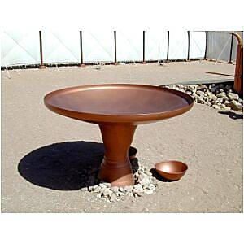
The Bronze Laver

Slide 12
New Testament Scripture
(1Jn 1:9) If we confess our sins, he is faithful and just to forgive us our sins, and to cleanse us from all unrighteousness.

Slide 13
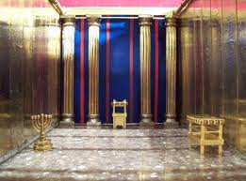
The Holy Place

Slide 14
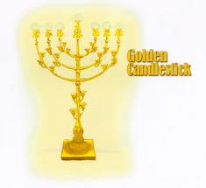
The Menorah

Slide 15
New Testament Scripture
(Joh 8:12) Then spake Jesus again unto them, saying, I am the light of the world: he that followeth me shall not walk in darkness, but shall have the light of life.
(Joh 12:46) I am come a light into the world, that whosoever believeth on me should not abide in darkness.

Slide 16
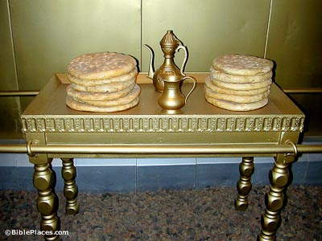
The Table of Showbread

Slide 17
New Testament Scripture
(Joh 6:32) Then Jesus said unto them, Verily, verily, I say unto you, Moses gave you not that bread from heaven; but my Father giveth you the true bread from heaven.
(Joh 6:35) And Jesus said unto them, I am the bread of life: he that cometh to me shall never hunger; and he that believeth on me shall never thirst.

Slide 18
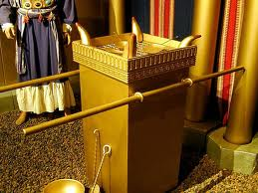
The Golden Alter of Incense

Slide 19
New Testament Scripture
(Psa 141:2) Let my prayer be set forth before thee as incense; and the lifting up of my hands as the evening sacrifice.
(Rom 8:34) Who is he that condemneth? It is Christ that died, yea rather, that is risen again, who is even at the right hand of God, who also maketh intercession for us.

Slide 20
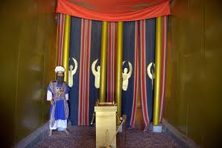
The Holy of Holies and the Veil

Slide 21
New Testament Scripture
(Heb 10:19) Having therefore, brethren, boldness to enter into the holiest by the blood of Jesus,
(Heb 10:20) By a new and living way, which he hath consecrated for us, through the veil, that is to say, his flesh;
(Heb 10:21) And having an high priest over the house of God;

Slide 22
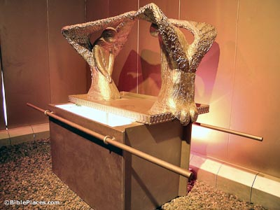
The Ark of the Covenant and the Mercy Seat

Slide 23
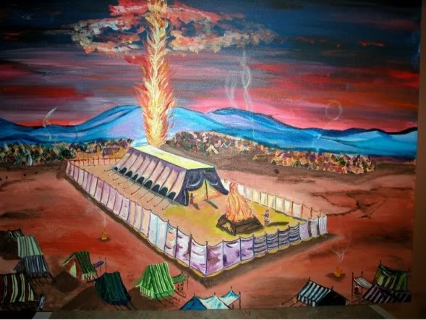
Pillar of Fire

Slide 24
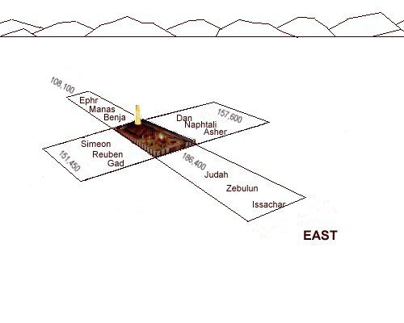
Lay out of the Camp

