Slide 1
Job
The Problem of Suffering

Slide 2
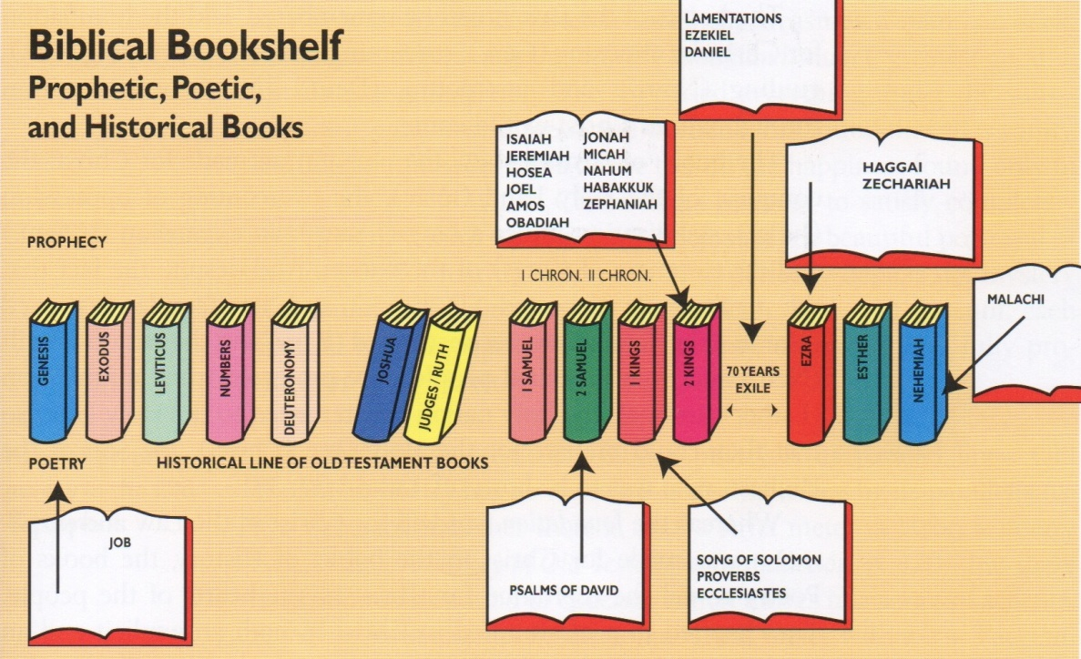
The Bibliographical Sketch

Slide 3
Facts about job
It is believed to be the oldest book in the world
Most likely from the patriarchal period
(Abraham, Isaac, and Jacob)
No reference to the exodus or the law of Moses
Characteristic patriarchal name of God “The Almighty” occurs more than 30 times
Longevity of life is comparative of the patriarchal period (Job live 140 years after his family)
Many place it between Gen. Ch.11 and 12
Others suggest he was a son of Issachar (Gen. Ch.46)

Slide 4
Facts about job
Author unknown but some think it may have been Moses
Comes from before Moses’ day – no reference to the mosaic law or the exodus
Mosaic terms : sons of God, fire from God, etc.
Theme of suffering fits with Moses’ concern for the suffering Israelites
They believe he would have composed it in the Median desert

Slide 5
Theme of job
Theme – the suffering of the righteous
“Job consists of a prologue, a dialogue, and an epilogue, the dialogue being in poetry and the other parts in prose”
There is a introduction, a conversation, and a conclusion
There is first and introduction about Job and what happens to him (prose)

Slide 6
Theme of job
Then Job and his friends wrestle with the question of why the Godly suffer and why God is silent (poetry)
They cannot find the answer until God speaks in the final chapters (prose)
“The presence of pain is allowed by the providence of God for the purifying and perfecting of his people” (Geisler)

Slide 7
Outline
How He Faced Calamity (1:1-2:13)
Job in the Hands of Satan
How He Faced Criticism (3:1-37:24)
Job in the Hands of Men
How He Faced Conviction (38:1-42:6)
Job in the Hands of God

Slide 8
How He Faced Calamity (1:1-2:13)
Job Compassed with Blessings (V.1-3)
READ
10 children, 7,000 sheep, 3,000 camels, 500 yoke of oxen, 500 she-asses, a very great household
He was the greatest man in the East
“in an age when material prosperity was the mark of spiritual blessing, Job excelled”
Job was “perfect and upright, eschewed evil, feared God”

Slide 9
How He Faced Calamity (1:1-2:13)
Job commented on his own righteousness when disputing with his friends
He never looked with lust, was a father of the fatherless, friend and helper of the widow, no stranger ever escaped his hospitality
“unfortunately, Job’s catalog of his acts of righteousness savors of self-righteousness”
He used pronouns I, me, my 195 times)

Slide 10
How He Faced Calamity (1:1-2:13)
Now the story turns bad
(Job 1:6) Now there was a day when the sons of God came to present themselves before the LORD, and Satan came also among them.
(Job 1:7) And the LORD said unto Satan, Whence comest thou? Then Satan answered the LORD, and said, From going to and fro in the earth, and from walking up and down in it.
(Job 1:8) And the LORD said unto Satan, Hast thou considered my servant Job, that there is none like him in the earth, a perfect and an upright man, one that feareth God, and escheweth evil?

Slide 11
How He Faced Calamity (1:1-2:13)
(Job 1:9) Then Satan answered the LORD, and said, Doth Job fear God for nought?
(Job 1:10) Hast not thou made an hedge about him, and about his house, and about all that he hath on every side? thou hast blessed the work of his hands, and his substance is increased in the land.
(Job 1:11) But put forth thine hand now, and touch all that he hath, and he will curse thee to thy face.
And the devils begins to attack

Slide 12
How He Faced Calamity (1:1-2:13)
Job Crippled by Bankruptcy (v.13-17)
His fortune was swept away in a series of disasters
While grazing in the hills his oxen and donkeys were carried off by the Sabeans
Lightening destroyed his flock of 7,000 sheep
3 bands of Chaldean’s killed his servants and stole his camels
And almost instantly Job was bankrupt

Slide 13
How He Faced Calamity (1:1-2:13)
Job Crushed with Bereavement
A tornado sweeps through where his children were gathered and kills them all
(Job 1:18) While he was yet speaking, there came also another, and said, Thy sons and thy daughters were eating and drinking wine in their eldest brother's house:
(Job 1:19) And, behold, there came a great wind from the wilderness, and smote the four corners of the house, and it fell upon the young men, and they are dead; and I only am escaped alone to tell thee.

Slide 14
How He Faced Calamity (1:1-2:13)
Most people would have been ready to give up by now and curse God
(Job 1:20) Then Job arose, and rent his mantle, and shaved his head, and fell down upon the ground, and worshipped,
(Job 1:21) And said, Naked came I out of my mother's womb, and naked shall I return thither: the LORD gave, and the LORD hath taken away; blessed be the name of the LORD.
(Job 1:22) In all this Job sinned not, nor charged God foolishly.

Slide 15
How He Faced Calamity (1:1-2:13)
Job Covered With Boils
He lost his family and fortune, and then he lost his health
Struck down with a horrible, disfiguring, painful disease
Covered from his head to his feet in boils
(Job 2:8) And he took him a potsherd to scrape himself withal; and he sat down among the ashes.
Now all he had left was his wife

Slide 16
How He Faced Calamity (1:1-2:13)
Job Cursed with Bitterness
“a man who has an understanding, sympathetic, courageous, and spiritual wife to share his joys and sorrows still has something far above the price of rubies”
But now Job’s wife now turns against him
(Job 2:9) Then said his wife unto him, Dost thou still retain thine integrity? curse God, and die.
The devil was using his own wife
(Job 1:11) But put forth thine hand now, and touch all that he hath, and he will curse thee to thy face.
Job immediately stops her

Slide 17
How He Faced Calamity (1:1-2:13)
(Job 2:10) But he said unto her, Thou speakest as one of the foolish women speaketh. What? shall we receive good at the hand of God, and shall we not receive evil? In all this did not Job sin with his lips.
Through the trial Job was victorious
A battle for Job’s loyalty had gone on between God and Satan and God won
“His life had become a stage upon which two great protagonists had fought for his loyalty and his soul. All heaven and all hell had watched with bated breath as God and Satan had fought this titanic struggle”

Slide 18
How He Faced Calamity (1:1-2:13)
Satan was defeated and his voice is not heard again in the old testament
But why did things not get better for Job?
“The answer is that God intended to use the calamites that had overtaken Job to teach him some truths about himself”
He was taken out of the hands of Satan and put in the hands of men

Slide 19
How he faced criticism (3:1-37:24)
Job and the Critics (3:1-31:40)
He was so triumphant over Satan but failed miserably before men
The criticism was unfair and untrue, but God used it to show Job the evils things within him
Bitterness, pride, sarcasm, anger, impatience, and self-righteousness
“when a bottle is upset, what is inside spills out. Upsetting the bottle does not determine the contents – it just displays the contents”

Slide 20
How he faced criticism (3:1-37:24)
Four men approached (3 older and the last younger)
Eliphaz the Temanite
Bildad the Shuhite
Zophar the Naamathite
Elihu the son of Barachel the Buzite
The book is mostly about the things these men said to Job and the things that Job said back to them

Slide 21
How he faced criticism (3:1-37:24)
Eliphaz: The man with the Exotic Experience
He like to talk about spirits and visions
“if you had not had his experience, then you evidently had missed out in your spiritual life”
He suggest that Job had been a great sinner, otherwise it would not have happened to him
“Behold, thou hast instructed many….But now it is come upon thee, and thou faintest”(4:3,5)
“Behold happy is the man the God correcteth: therefore despise not thou the chastening of the Almighty (5:17)

Slide 22
How he faced criticism (3:1-37:24)
“Remember, I pray thee, who ever perished, being innocent?...I have seen, they that plow iniquity, and sow wickedness, reap the same” (4:7-8)
“Job…you should be singing man…you should be happy”
“with an objectivity we often find so easy to apply to someone else’s sorrow, he told Job to be happy because whom the Lord loveth he chasteneth”

Slide 23
How he faced criticism (3:1-37:24)
Bildad: The Man with Clever Clichés
Bildad was far worse than Eliphaz
Bildad supposed that Job was a sinner
He had an answer for everything
“Doth God pervert judgment?...If thou wert pure and upright; surely now he would take away for thee, and make the habitation of they righteousness prosperous” (8:3,6)
He basically said “Job, you are nothing but a hypocrite”

Slide 24
How he faced criticism (3:1-37:24)
Zophar: The Man With the Made-up Mind
He was a know it all and a very callous man
He did not suggest or suppose, he bluntly said that Job was a sinner
(Job 11:5) But oh that God would speak, and open his lips against thee;
(Job 11:6) And that he would shew thee the secrets of wisdom, that they are double to that which is! Know therefore that God exacteth of thee less than thine iniquity deserveth.
“Job if you were getting what you deserved, you would be dead”

Slide 25
How he faced criticism (3:1-37:24)
Job had lost everything and was in physical, mental, and spiritual agony
Job sometimes reacted in anger
(Job 13:4) But ye are forgers of lies, ye are all physicians of no value.
(Job 13:5) O that ye would altogether hold your peace! and it should be your wisdom.
“if you would keep your mouths shut, somebody might make a mistake and imagine you were wise men”

Slide 26
How he faced criticism (3:1-37:24)
Job sometimes reacted in agony
He accused God of cruelty, injustice, and indifference
Thou knowest that I am not wicked…yet thou dost destroy me…Hast thou not poured me out as milk, and curdled me like cheese (10:7-10)
Job sometimes reacted in assurance
Then came a tremendous statement of faith
(Job 19:25) For I know that my redeemer liveth, and that he shall stand at the latter day upon the earth:

Slide 27
How he faced criticism (3:1-37:24)
(Job 19:26) And though after my skin worms destroy this body, yet in my flesh shall I see God:
“in the whole bible is no greater statement of the physical, bodily resurrection of the believer until we come to the fifteenth chapter of Paul’s first letter to the Corinthians! And Job had never seen a single page of scripture”
Even before the bible was written God was pointing men towards the return of Christ

Slide 28
How he faced criticism (3:1-37:24)
Job and the Comforter (32:1-37:24)
Job had prayed for a “daysman”
An umpire or arbiter; a mediator
(Job 33:6) Behold, I am according to thy wish in God's stead: I also am formed out of the clay.
Elihu bridged the gap between Job and his friends and Job and his God
But even He corrected Job more than he consoled him
(Job 34:33) Should it be according to thy mind? he will recompense it…

Slide 29
How he faced conviction (38:1-42:17)
All of them were wrong about Job’s suffering
Job himself, his wife, Eliphez, Bildad, Zophar, and Elihu
We read the first 2 chapters and we know why it happened
Then we can see the last chapter and how it all ended
But Job did not know these facts
They were arguing from incomplete data
“God usually does not tell us why trials and troubles come upon us; He wants us to trust Him even when everything looks hopeless and black”
How foolish to criticize another person

Slide 30
How he faced conviction (38:1-42:17)
Job in the hands of God
How He was Rebuked (38:1-42:6)
God asked Job a series of questions about the material universe
Where wast thou when I laid the foundations of the earth? (38:4)
Hast thou commanded the morning since thy days? (38:12)
Doth the eagle mount up at thy command (39:27)

Slide 31
How he faced conviction (38:1-42:17)
“you have had a lot to say about things…but you don’t know how I do things”
Job had nothing to reply to God but…
I abhor myself, and repent in the dust and ashes (42:6)
How he was Released (42:7-10)
(Job 42:10) And the LORD turned the captivity of Job, when he prayed for his friends…
“God set him free from his own misery, brought on by his wrong reactions to his critics, when he got down on his knees and prayed for them”

Slide 32
How he faced conviction (38:1-42:17)
How He was Rewarded (42:11-17)
He was given back his fortune and his family
(Job 42:10) And the LORD turned the captivity of Job, when he prayed for his friends: also the LORD gave Job twice as much as he had before.
(Job 42:12) So the LORD blessed the latter end of Job more than his beginning: for he had fourteen thousand sheep, and six thousand camels, and a thousand yoke of oxen, and a thousand she asses.
(Job 42:13) He had also seven sons and three daughters.

Slide 33
How he faced conviction (38:1-42:17)
He ended up with twice as many of everything that he started with
Double the sheep, camels, oxen, and she-asses
But only 10 more children
“the time came when Job died and went to heaven and, in due course, the last of his children died and went to heaven. Then Job stood up in the presence of God and counted up his children and, sure enough, he had fourteen sons and six daughters”
So by then end of it He was more blessed than he had ever dreamed

Slide 34
Blessed be the name of the lord
(Job 1:21) And said, Naked came I out of my mother's womb, and naked shall I return thither: the LORD gave, and the LORD hath taken away; blessed be the name of the LORD.
Sometimes things happen in our life
It may not be because of something you did
But God is the one that gave us everything
And He honestly has a right to take everything
But no matter what “bless be the name of the Lord”
Our job is to worship him no matter what

Slide 35
Blessed be the name of the lord
We may not understand why things happen the way they do
But one day we will be in heaven and we will be more blessed than you ever imagined
And we will be able to ask God why things happened the way they did
Our job is to praise Him no matter what
(Psa 43:5) Why art thou cast down, O my soul? and why art thou disquieted within me? hope in God: for I shall yet praise him, who is the health of my countenance, and my God.

