Slide 1
I. Samuel
A Book of Transition

Slide 2
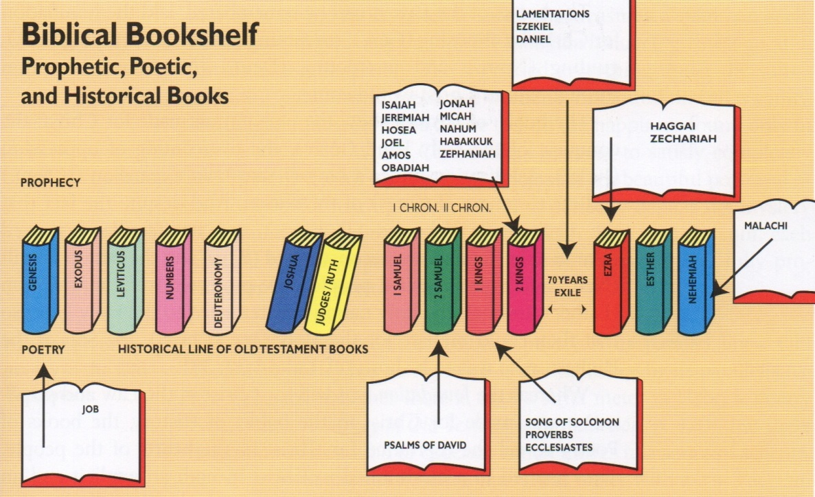
2. The Bibliographical Sketch

Slide 3
I Samuel
Samuel is a book of transition
Period of judges lasted some 400 years
For the most part the judges were soldiers or strong men
Eli was a priestly judge
Samuel was a prophet judge
The transition from judges to kings
The transition from a theocracy to a monarchy

Slide 4
I Samuel
For the most part the judges were soldiers
Gideon and Sampson
But in the book of Samuel we see the last 2 judges were different
Eli was a priestly judge
Samuel was a prophet judge
But the nation clamored for a King and Samuel was the last of the judges

Slide 5
Outline of I Samuel
A Dying Theocracy (Ch. 1-7)
Eli: The Established Priest
Samuel: The Enlightened Prophet
The Dawning Monarchy (Ch. 8-31)
The tragedy of Saul
The Training of David

Slide 6
1. A Dying Theocracy
Eli: The Established Priest
His failure as a priest
No spirtual vitality -(1Sa 1:9) …Now Eli the priest sat upon a seat by a post of the temple of the LORD.
3 times we see him in the bible – propped against pillars
Laying in bed, and sitting in a seat
Only priest in OT we see sitting

Slide 7
1. A Dying Theocracy
No spiritual vision – (1Sa 3:1) And the child Samuel ministered unto the LORD before Eli. And the word of the LORD was precious in those days; there was no open vision.
The Lord was not speaking but the priest was not teaching
No spiritual values - (1Sa 2:29) …and honourest thy sons above me, to make yourselves fat with the chiefest of all the offerings of Israel my people?

Slide 8
1. A Dying Theocracy
Eli: The Established Priest
2) His failure as a Parent
Unregenerate - (1Sa 2:12) Now the sons of Eli were sons of Belial; they knew not the LORD.
They looked like priest but were wicked
“its not always mans fault if his children are unregenerate…there is many a godly parent who has an ungodly child”
But in Eli’s case – he was still allowing them to function as priest

Slide 9
1. A Dying Theocracy
Unrestrained - (1Sa 2:22) …they lay with the women that assembled at the door of the tabernacle of the congregation.
“Eli never restrained them when they were young. Now, he who would not restrain them could not retrain them”
Unrepentant - (1Sa 2:25) …Notwithstanding they hearkened not unto the voice of their father…
God himself told them to repent but their hearts had hardened
“it is not that they were sinners…it is that we will not repent when confronted with the cold, hard evidence of our sin”

Slide 10
1. A Dying Theocracy
Samuel: The enlightened Prophet
He bridged the gap between the priests and the Kings
He founded the order of the prophets in the nation of Israel
He was the king maker for the nation
He anointed Saul and David
“He ranks with Abraham and Moses as men raised up by God to provide leadership for Israel”

Slide 11
1. A Dying Theocracy
Every time God needs Samuel he is there
When wars were fought - (1Sa 7:13) So the Philistines were subdued, and they came no more into the coast of Israel: and the hand of the LORD was against the Philistines all the days of Samuel.
When the word was taught – (1Sa 7:17) …and there he judged Israel; and there he built an altar unto the LORD.
When the will of God was sought -(1Sa 12:23) Moreover as for me, God forbid that I should sin against the LORD in ceasing to pray for you: but I will teach you the good and the right way:

Slide 12
Outline of I Samuel
A Dying Theocracy (Ch. 1-7)
Eli: The Established Priest
Samuel: The Enlightened Prophet
The Dawning Monarchy (Ch. 8-31)
The tragedy of Saul
The Training of David

Slide 13
2. The dawning Monarchy
The Tragedy of Saul
He was an impressive man
He was head and shoulder above anyone else
Comparable to Eliab, the son of Jesse
(1Sa 16:7) But the LORD said unto Samuel, Look not on his countenance, or on the height of his stature; because I have refused him: for the LORD seeth not as man seeth; for man looketh on the outward appearance, but the LORD looketh on the heart.

Slide 14
2. The dawning Monarchy
He was an impatient man
Saul lost his kingdom for an act of impatience
The Philistines were defeating him
Samuel had promised to come and bless but was late
(1Sa 13:9) And Saul said, Bring hither a burnt offering to me, and peace offerings. And he offered the burnt offering.

Slide 15
2. The dawning Monarchy
He was an impenitent man
God gave him the victory over Amalek but he spared the king and the best cattle
Samuel called his sin “rebellion”
David sinned about as badly as Saul
But David threw himself prostrate on the floor before God and begged for forgiveness.

Slide 16
2. The dawning Monarchy
The Training of David
Now we see a man after God’s own heart
The man that God intended to be their King
Saul was a herder of mules
But David was a keeper of sheep
Saul was used to driving and David to leading
First time we see Saul he lost hid Fathers mules and had no idea how to find them
First time we see David he was keeping his fathers sheep and willing to give his life for the flock

Slide 17
2. The dawning Monarchy
In the Country
God molded David’s Character
Tending the herd as a Shepard living quietly in the will of God
Fighting of wolves, lions and bears to protect his flock
In the Camp
God manifested David’s Courage
War broke out between the Philistines and Israel
Israel was in fear of Goliath
David came a slew the giant

Slide 18
2. The dawning Monarchy
At the Court
God marked David’s conduct
David was summoned to Saul’s court to play the harp
Saul saw David as a rival for the throne and tried to kill David many times
(1Sa 18:14) And David behaved himself wisely in all his ways; and the LORD was with him.

Slide 19
2. The dawning Monarchy
In the Cave
David became a fugitive from Saul
More than once David could have killed Saul but refused to kill him because he was the “Lord’s anointed”
David was learning patience
And he found refuge in the cave of Adullam

Slide 20
2. The dawning Monarchy
God used the different places and positions of David’s life to shape and mold him
In the country – his character
In the camp – his courage
In the court – his conduct
In the cave – his convictions
“thus every circumstance in David’s life was made to minister to him top prepare him for the day…”
And they taught him to trust in the Lord no matter what

Slide 21
2. The dawning Monarchy
(Psa 142:1) Maschil of David; A Prayer when he was in the cave. I cried unto the LORD with my voice; with my voice unto the LORD did I make my supplication.
(Psa 142:2) I poured out my complaint before him; I shewed before him my trouble.
(Psa 142:3) When my spirit was overwhelmed within me, then thou knewest my path. In the way wherein I walked have they privily laid a snare for me.

Slide 22
2. The dawning Monarchy
(Psa 142:4) I looked on my right hand, and beheld, but there was no man that would know me: refuge failed me; no man cared for my soul.
(Psa 142:5) I cried unto thee, O LORD: I said, Thou art my refuge and my portion in the land of the living.
(Psa 142:6) Attend unto my cry; for I am brought very low: deliver me from my persecutors; for they are stronger than I.

Slide 23
2. The dawning Monarchy
(Psa 142:7) Bring my soul out of prison, that I may praise thy name: the righteous shall compass me about; for thou shalt deal bountifully with me.
He was fearful and he was friendless
But he had learn where to find his help
He had learned that he could trust in the Lord

