Slide 1
Ezra
The Godly Scribe

Slide 2
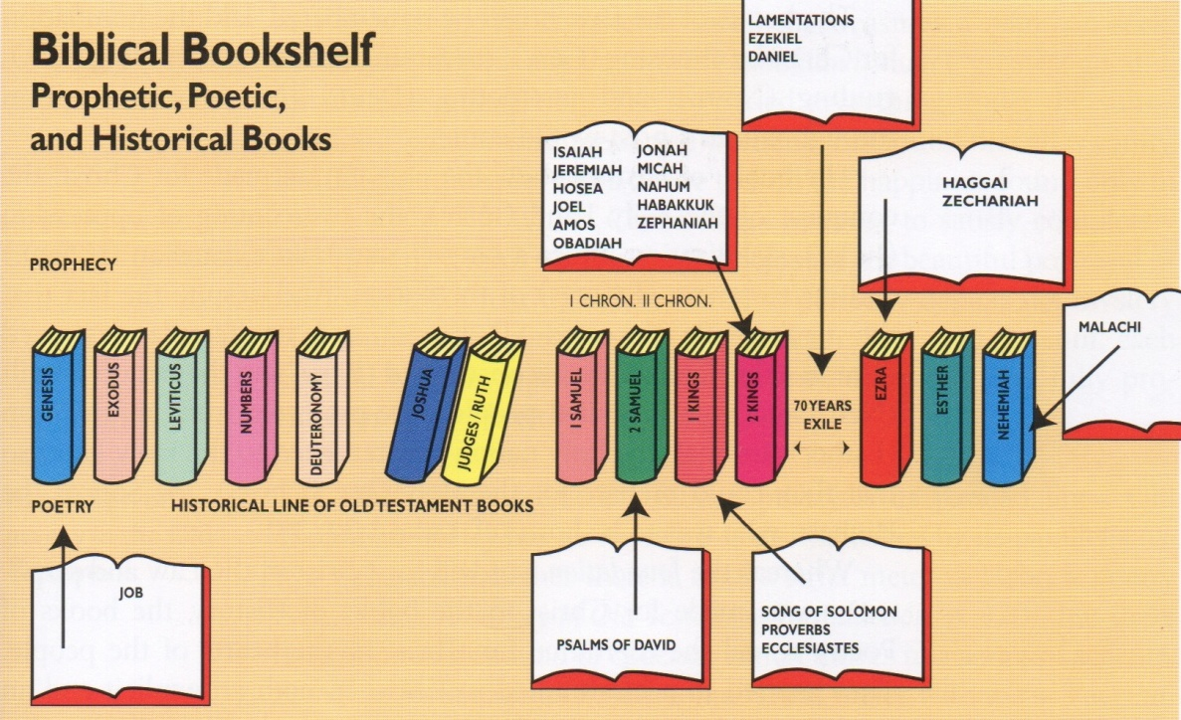
The Bibliographical Sketch

Slide 3
The Monarchy
The 12 tribes were united and ruled from a single throne for 120 years
Saul, David, and Solomon – 40 years each
After the death of Solomon 10 tribes broke away from the throne of David to set up an independent kingdom to the north
10 tribes to the north – Israel
2 tribes to the south (Judah and Benjamin) - Judah

Slide 4
The Monarchy
Israel
Judah
Ruled from Samaria
10 tribes
19 Kings
7 dynasties
All wicked
Lasted c. 200 years
Ruled from Jerusalem
2 tribes
20 Kings
1 dynasty
8 good kings
Lasted c. 350 years

Slide 5
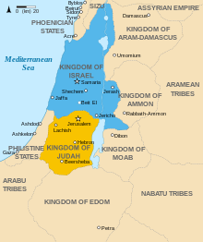

Slide 6
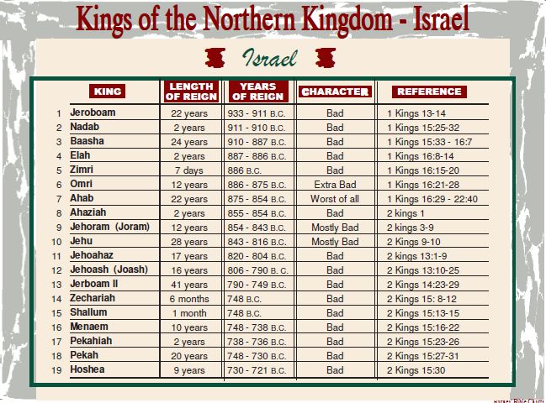

Slide 8
The Repetition Principle
God repeats some truth or subject already given, generally with additions not given before
It can be a single word, phrase, or entire doctrine
As if God is saying “take note here”
The first account often contains man’s viewpoint and the repetition will often contain the divine viewpoint
Ex. The 4 gospels -King, Servant, Man, God

Slide 9
The Repetition Principle
1 & 2 Samuel / 1 & 2 Kings
1 & 2 Chronicles
Human viewpoint
Facts of history
What happened
How man ruled
Governmental
Kingly
Wars
Divine viewpoint
Philosophy of history
Why it happened
How God over-ruled
Ecclesiastical
Priestly
Revival

Slide 10
The Repetition Principle
Wars
Kings
3 chapters given to the war of Hezekiah
only 3 verse given to the great revival
Chronicles
3 chapters given to the revival under Hezekiah
1 chapter given to the wars

Slide 11
The Repetition Principle
Ark of the Covenant
II Samuel – Only 1 chapter devoted to the transportation of the Ark of the Covenant
Chronicles - 3 chapters are given to this event (emphasis on Levites, temple and religious life)
David’s great sin –
I Samuel – 2 chapter
Chronicles – not mentioned
Saul – I Samuel (20 Ch.) vs. Chronicles (1 Ch.)

Slide 12
Interesting Facts
The book of Kings was written before the Babylonian captivity began
The book of Chronicles was written after the Babylonian captivity ended
After the remnant returned to the land of promise
The city was rubble, the temple gone, and the land was desolate
The book of Ezra is the story of their return back to the promised land after the Babylonian captivity

Slide 13
The Babylonian Captivity
The captivity of Judah was in 3 stages
605 B.C. - Nebuchadnezzar captured Jehoiakim and leading nobles including Daniel
597 B.C. – King Jehoiachin was captured along with other people of importance like Ezekiel and the ancestors of Mordecai
586 B.C. – the final destruction of Jerusalem. King Zedekiah entered allegiance with Egypt and Nebuchadnezzar attacked and destroyed the city and burnt the temple

Slide 14
The Babylonian Captivity
No historical book offers running narrative of the captivity
The prophetic books Jeremiah, Ezekiel, and Daniel pertain to the exile
God had promised to bring his people back in to their land in Jeremiah 25
Ezra is the record of the return of the remnant to their homeland and their struggles to rebuild the Temple and the re-establish the nation’s religion

Slide 15
The Returning Remnant
The return of the Remnant was also in 3 stages
583 B.C. – Cyrus the Persian issued a decree setting the Jews free. Zerubbabel led the first group of 49,690 back to Jerusalem
485 B.C. – a group returned under the leadership of Ezra
445 B.C. – Nehemiah, a high official in the Persian court, was given permission to return to rebuild the walls of Jerusalem

Slide 16
The Returning Remnant
Known as the second Exodus
1st - Egypt to Canaan
2nd - Babylon to Canaan
Both were prophetic
Egypt – Genesis 15:13-14
Babylon – Jeremiah 25:11-12, 29:10-11
(Jer 29:10) For thus saith the LORD, That after seventy years be accomplished at Babylon I will visit you, and perform my good word toward you, in causing you to return to this place.

Slide 17
The Outline
The First Revival (20 years):
God Used a Prince
Emphasis: Divine Sovereignty in Revival (Ch. 1-6)
The Further Revival (1 year, 58 years later):
God used a Priest
Emphasis: Human Sanctity in Revival
(Ch.7-10)

Slide 18
I. The 1st Revival: God Used a Prince
Zerubbabel was a descendant of David and was the only of person of the royal bloodline to return at this time
He was appointed the first governor of the reborn land of Israel
The first revival included 33 families, 4 groups of priest, and some Levites. A group of 49,690
Estimated 2-3 million Jews scattered in Persia
The trip was long and hazardous, 700 miles taking 5 months to cross

Slide 19
6 Different Movements in the 1st Revival
Waking (Ch.1-2)
Israel outside of the promised land was outside of their place of blessing
Before God could make good on his promises, he needed to bring them back to the place where He could bless them
(Ezr 1:5) Then rose up the chief of the fathers of Judah and Benjamin, and the priests, and the Levites, with all them whose spirit God had raised, to go up to build the house of the LORD which is in Jerusalem.

Slide 20
6 Different Movements in the 1st Revival
The first movement was one of waking
The tragedy is that so few responded to it
There were plenty of people ready to give money when they saw God at work
(Ezr 1:6) And all they that were about them strengthened their hands with vessels of silver, with gold, with goods, and with beasts, and with precious things, beside all that was willingly offered.

Slide 21
6 Different Movements in the 1st Revival
“God makes note of that as He makes note of any gesture made towards Himself, but he reserved His blessing for those who went”
Worshipping (Ch. 3:1-4)
“When God begins to revive the human heart, true worship is always the result”
(Ezr 3:6) From the first day of the seventh month began they to offer burnt offerings unto the LORD. But the foundation of the temple of the LORD was not yet laid.

Slide 22
6 Different Movements in the 1st Revival
The burnt offering is an offering done solely for worship of God
They kept the feast of the Tabernacles which was the most joyful holiday on the Jewish calendar
“The burnt offering brought joy to the heart of God; the feast of the Tabernacles brought joy to the heart of man”
You can have worship without revival but not revival without worship

Slide 23
6 Different Movements in the 1st Revival
Working (Ch.3:8-13)
Ezra 3:8 In the 2nd year of their coming…began Zerubbabel…to set forward the work of the house of the Lord
Worship is always followed by service
The house of the Lord was rebuilt and
..and all the people shouted with a great shout
The world began to take note
You can not keep revival a secret

Slide 24
6 Different Movements in the 1st Revival
Warring (Ch. 4)
Subtle opposition came first
The Samaritans wanted to help in the building
They were not moved by the spirit of God
Zerubbabel knew the difference
Gods does not need the worlds help to build his house
When told no they did everything in their power to oppose the revival
“Then the work ceased”

Slide 25
6 Different Movements in the 1st Revival
Witnessing (Ch.5)
…the prophets Haggai…and Zechariah...prophesied unto the Jews…Then rose up Zerubbabel…and Jeshua…and began to build the house of God (1-2)
God sent His men with His word to continue the revival
“the new work for God was guided and guarded by the word of God”
Real revival comes from the word of God

Slide 26
6 Different Movements in the 1st Revival
Winning (Ch.6)
The work of the temple was finished
But the revival could not last
No revival has ever lasted
It Was ended within one generation
“hundreds of churches and Christian organizations attest to the fact that a movement that ceases to move becomes a monument”

Slide 27
The Transition
There are 58 years between Ezra 6 and 7
The story of Esther takes place during this interim period
Many battles were fought during this period
Marathon, Thermopylae, and Salamis
In the east were the deaths of Confucius and Buddha

Slide 28
II. The Further Revival: God Used a Priest
3 Simple Steps
The Man (Ch.7)
The man God chosen was the man that later sat down and Chronicled the story of this book
Ezra was Israel's high priest
He was part of the Aaronic priest hood
“No permanent work can be done for God that does no find its ultimate center in God’s great high priest…Jesus Christ…God has no plans, no promises, no programs, no prospects for the earth that are not centered in the person and work of His beloved Son”

Slide 29
II. The Further Revival: God Used a Priest
Several generations had past since Zerubbabel had finished the temple and the 1st revival took place
And the people had neglected the word of God and were occupied by material things
“Spiritual realities, purchased at a high cost by the grandparents, very often come cheap and easy to the grandchildren”
To spark the revival Ezra determined to make the word of God the center of his life
(Ezr 7:10) For Ezra had prepared his heart to seek the law of the LORD, and to do it, and to teach in Israel statutes and judgments.

Slide 30
II. The Further Revival: God Used a Priest
The Movement (Ch. 8)
The movement of Ezra was spearheaded by several influential people
This in turn attracted other influential and powerful people
“An evidence of the outright sincerity of the people that responded”
Its easy to get a man that is poor and has nothing to come try something new

Slide 31
II. The Further Revival: God Used a Priest
The Mistake (Ch.9-10)
“Times of spiritual awakening always result in the exposure of sin”
The people born in the land after the 1st great revival had lost sight of a great spiritual truth
They had lost sight of the truth of separation from the world
God’s people and the world were co-mingled together

Slide 32
II. The Further Revival: God Used a Priest
(Ezr 9:1) Now when these things were done, the princes came to me, saying, The people of Israel, and the priests, and the Levites, have not separated themselves from the people of the lands…
The result of Ezra’s revival was conviction and confession of sin
I love the worship, and I love the excitement
But we will never see real revival until we become broken hearted over our sin

Slide 33
II. The Further Revival: God Used a Priest
One of the great intercessory prays of the Bible
We preached on the little space of grace
It took a remnant, reviving, and rebuilding
(Ezr 9:10) And now, O our God, what shall we say after this? for we have forsaken thy commandments,
In the last chapter all of the congregation confesses their sin and separated themselves from what was separating God from them

Slide 34
II. The Further Revival: God Used a Priest
(Ezr 10:11) Now therefore make confession unto the LORD God of your fathers, and do his pleasure: and separate yourselves from the people of the land, and from the strange wives.
(Ezr 10:12) Then all the congregation answered and said with a loud voice, As thou hast said, so must we do.
What do you think would happen if every person in our church repented of all of their sins

