Slide 1
The Books of poetry
Music of The Heart

Slide 2
The Bibliographical Sketch

Slide 3
Divisions of the O.T.
The O.T. can be divided into 4 sections
Law: The Foundation For Christ
legal literature – moral life of God’s people
“Moses laid down the ethical code which governed the conduct of the theocratic nation”
History: The Preparation For Christ
Historical literature – national life of people
“These books from Joshua to Nehemiah depict the political life in view of these moral norms”

Slide 4
Divisions of the O.T.
Poetry: The Aspiration For Christ
Poetical literature – spiritual life of people
“These books reflect the spiritual experiences of the people. These religious experiences comprise some of the greatest treasures of the OT and even of world literature”
Prophecy: The Expectation For Christ
Prophetical literature – future life of people
These books point forward to the future for God’s people…some has already been fulfilled and some are yet to come

Slide 5
The Bibliographical Sketch

Slide 6
Periods of Poetry
Patriarchal period – Job (c. 2,000 B.C.)
Davidic Period – Psalm (c. 1,000 B.C.)
Solomonic Period (c. 950 B.C.)
Song of Solomon – a young man’s love
Proverbs – a middle-aged man’s wisdom
Ecclesiastes – an old man’s sorrow

Slide 7
The Aspiration For Christ
Job – aspiration for mediation by Christ
“working out the practical context of everyday suffering, cried out for a mediator, someone who could plead his cause with God and unfold the mystery of his calamities”
(Job 9:33) Neither is there any daysman betwixt us, that might lay his hand upon us both.
(Job 19:25-26) For I know that my redeemer liveth, and that he shall stand at the latter day upon the earth: And though after my skin worms destroy this body, yet in my flesh shall I see God:

Slide 8
The Aspiration For Christ
Psalms – aspiration for communion with Christ
“there desire is for communion with God in discouragements, despair, triumphs, or life. This intimate fellowship with God was provided by Christ”
Proverbs – aspiration for wisdom in Christ
“Proverbs manifest a desire for wisdom which the NT informs us is found in Christ alone”
(Col 2:2) That their hearts might be comforted, being knit together in love, and unto all riches of the full assurance of understanding, to the acknowledgement of the mystery of God, and of the Father, and of Christ;(Col 2:3) In whom are hid all the treasures of wisdom and knowledge.

Slide 9
The Aspiration For Christ
Ecclesiastes – aspiration for ultimate satisfaction
A search for the greater good
“Solomon tried everything under the sun – including wine, worldliness, and women – but found that all is vanity. His quest reveals that happiness is found only in the water so life which Christ offers”

Slide 10
The Aspiration For Christ
Song of Solomon – aspiration for union in love with Christ
“A beautiful portrayal of the longing for marital union which so perfectly depicts the mystery of the union of believers with Christ”
(Eph 5:31) For this cause shall a man leave his father and mother, and shall be joined unto his wife, and they two shall be one flesh.(Eph 5:32) This is a great mystery: but I speak concerning Christ and the church.
Every poetical book seeking after the things that can only be acquired through Christ

Slide 11
Hebrew poetry
There are several major forms of poetry
Dirge - a mournful song, piece of music, or poem
All of the book of Lamentations
Drama - an exciting, emotional, or unexpected series of events or set of circumstances
Elegy - a poem of serious reflection, typically a lament for the dead
David's elegy for Saul and Jonathan in 2 Samuel
Epic - a long poem, typically one derived from ancient oral tradition, narrating the deeds and adventures of heroic or legendary figures or the history of a nation.

Slide 12
Hebrew poetry
Idyll - an extremely happy, peaceful, or picturesque episode or scene, typically an idealized or unsustainable one
Lyric - expressing the writer's emotions, usually briefly and in stanzas or recognized forms
Psalms 22 is an example of lyrical poetry in which deep feelings of the heart are bared rather than some outward incident described
Ode - a lyric poem in the form of an address to a particular subject

Slide 13
Hebrew poetry
western poetry has rhyme and rhythm
Robert Frost
“Hebrew poetry depends on parallelism of thought rather than a phonetic coupling of words”
An idea is stated one way and then repeated another and is done in 4 ways
Synonymous Parallelism
Antithetic Parallelism
Synthetic Parallelism
Exemplar Parallelism

Slide 14
Synonymous poetry
The second half of the verse repeats the content of the first half, only in different words
(Psa 2:5) Then shall he speak unto them in his wrath, and vex them in his sore displeasure.
(Psa 140:1) To the chief Musician, A Psalm of David. Deliver me, O LORD, from the evil man: preserve me from the violent man;
(Job 38:7) When the morning stars sang together, and all the sons of God shouted for joy?

Slide 15
Antithetic parallelism
A thought is stated in the first verse, only to be set out in contrast, or antithesis, in the second
(Psa 34:10) The young lions do lack, and suffer hunger: but they that seek the LORD shall not want any good thing.
(Pro 12:10) A righteous man regardeth the life of his beast: but the tender mercies of the wicked are cruel.
(Pro 14:34) Righteousness exalteth a nation: but sin is a reproach to any people.

Slide 16
Synthetic Parallelism
A thought is given and then expanded in succeeding lines, each line building on the first
(Psa 1:3) And he shall be like a tree planted by the rivers of water, that bringeth forth his fruit in his season; his leaf also shall not wither; and whatsoever he doeth shall prosper.
(Pro 9:1) Wisdom hath builded her house, she hath hewn out her seven pillars: (Pro 9:2) She hath killed her beasts; she hath mingled her wine; she hath also furnished her table.

Slide 17
Exemplar parallelism
One line metaphorical illustration the literal truth of the other
(Pro 27:17) Iron sharpeneth iron; so a man sharpeneth the countenance of his friend.
(Pro 27:15) A continual dropping in a very rainy day and a contentious woman are alike.

Slide 18
Parallels
The parallels can be in couplets, triplets, and quatrains
Couplets - (Psa 36:5) Thy mercy, O LORD, is in the heavens; and thy faithfulness reacheth unto the clouds.
Triplets - (Job 3:9) Let the stars of the twilight thereof be dark; let it look for light, but have none; neither let it see the dawning of the day:
Quatrains - (Psa 1:3) And he shall be like a tree planted by the rivers of water, that bringeth forth his fruit in his season; his leaf also shall not wither; and whatsoever he doeth shall prosper.

Slide 19
Hebrew poetry
Poetry is found through out the Bible
The five poetical books
Job, Psalms, Proverbs, Ecclesiastes, Song of Solomon
The teaching of these 5 books are progressive
“beginning with the experiences of a renewed heart from the hour that the self is revealed in all its unattractiveness (Job 45:5-6) until Christ becomes all in all (Song of Solomon 5:16)
Summary of the books as follows

Slide 20
Job: The problem of pain
No greater problem than the suffering among men
Job gives us some answers to an age-old problem
“Will this man’s theology triumph over his experience, or will his experience triumph over his theology”

Slide 21
Job: The problem of pain
Lesson is to not judge by the outward appearance
The arguments put forward in the book are nearly all wrong because they are drawn from incomplete data
“There are reasons behind seemingly meaningless suffering and that, moreover, God can use our adverse circumstances to teach spiritual lessons”

Slide 22
Psalms: The Way to pray
Hebrew hymn book and Hebrew prayer book
“it touch's the chords of human experience and sounds all the notes of prayer, confession, petition, intercession, adoration, thanksgiving and praise”
All through the book is a prophetic, messianic conscious of Jesus Christ
The faithful man of Psalm 1
Became the forsaken man of Psalm 22
So that the filthy man of Psalm 14
Might become the forgiven man of Psalm 32

Slide 23
Psalms: The Way to pray
The Psalms are a mine of information about Bible prophecy
The two advents of Christ
(Psa 2:7) I will declare the decree: the LORD hath said unto me, Thou art my Son; this day have I begotten thee.
(Psa 96:13) Before the LORD: for he cometh, for he cometh to judge the earth: he shall judge the world with righteousness, and the people with his truth.

Slide 24
Psalms: The Way to pray
The great tribulation
(Psa 43:1) Judge me, O God, and plead my cause against an ungodly nation: O deliver me from the deceitful and unjust man.(Psa 43:2)
End-times judgment
(Psa 9:7) But the LORD shall endure for ever: he hath prepared his throne for judgment.(Psa 9:8) And he shall judge the world in righteousness, he shall minister judgment to the people in uprightness.

Slide 25
Psalms: The Way to pray
The millennial reign of Christ
(Psa 96:10) Say among the heathen that the LORD reigneth: the world also shall be established that it shall not be moved: he shall judge the people righteously.
Psalm also teaches us on the life and times of David, Hezekiah, and other historical figures of the Old Testament

Slide 26
Proverbs: The Behavior of the believer
Behind the book of proverbs is the shadow of Solomon’s wicked son Rehoboam
Solomon had a fool for a son and he knew it
Many of the Proverbs were doubtless written with that fact in mind
“But they were wasted on Rehoboam” – he did not listen
“Proverbs is a handbook on spiritual life, practical psychology, child raising, business ethics, and similar practical topics”

Slide 27
Proverbs: The Behavior of the believer
Behind the book of proverbs is the shadow of Solomon’s wicked son Rehoboam
Solomon had a fool for a son and he knew it
Many of the Proverbs were doubtless written with that fact in mind
“But they were wasted on Rehoboam” – he did not listen
“Proverbs is a handbook on spiritual life, practical psychology, child raising, business ethics, and similar practical topics”

Slide 28
Proverbs: The Behavior of the believer
(Pro 4:23) Keep thy heart with all diligence; for out of it are the issues of life.
(Pro 3:5) Trust in the LORD with all thine heart; and lean not unto thine own understanding.(Pro 3:6) In all thy ways acknowledge him, and he shall direct thy paths.
(Pro 22:6) Train up a child in the way he should go: and when he is old, he will not depart from it.
(Pro 13:11) Wealth gotten by vanity shall be diminished: but he that gathereth by labour shall increase.

Slide 29
Ecclesiastes: The folly of forgetting god
Behind the book of Ecclesiastes in the shame of Solomon
Solomon started of his reign rich with gifts from heaven and destroyed it all
He forgot God, lived for the world, wrecked his kingdom, and turned Jerusalem into Babylon
“Ecclesiastes is his apology letter”
This book shows us how worldly minded a man thinks

Slide 30
Song of Solomon: The art of adoration
Solomon wrote over 1,000 songs and this one he calls the “song of songs”
We can get the clearest picture of this great love song when interpreted in the light of Jesus Christ and his church
There is a love story going on between the Bride and Jesus Christ (Mathew 25:1-14)
One day Jesus is going to return for His bride
So the books of poetry constantly point us towards Christ and deepen our relationship with Him
It is truly amazing how Christ centered our entire Bible is

Slide 31
The books
John Phillips
Norman Geisler

Slide 32
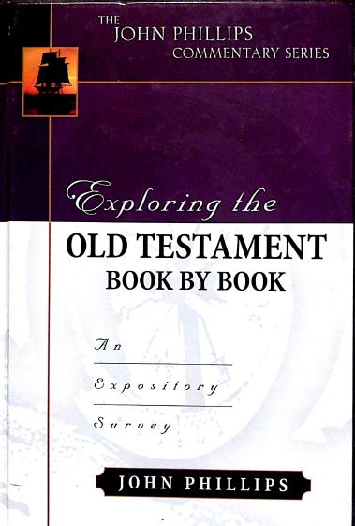

Slide 34
Norman L Geisler
Short and sweet
10 minutes worth of reading
For those that just “don’t have time” and for pre-work
Good to read before you study Bible
E.g. – Esther – to the Persian Jews, Xerxes, etc.
Very historical and literal
Do not know him as well as Phillips

Slide 35
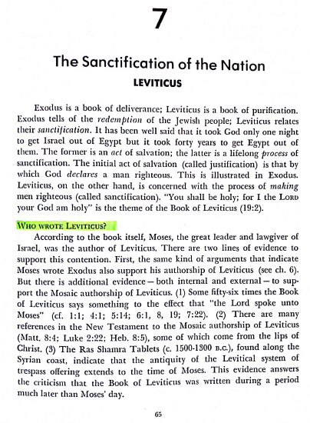

Slide 36
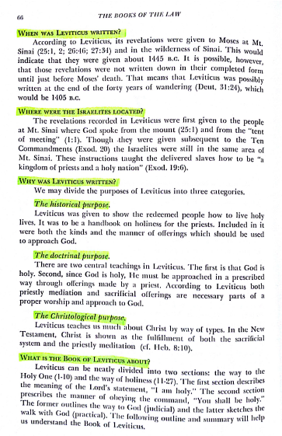

Slide 37
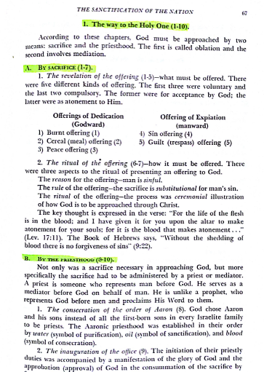

Slide 38
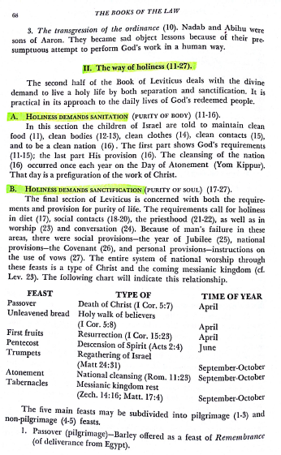

Slide 39
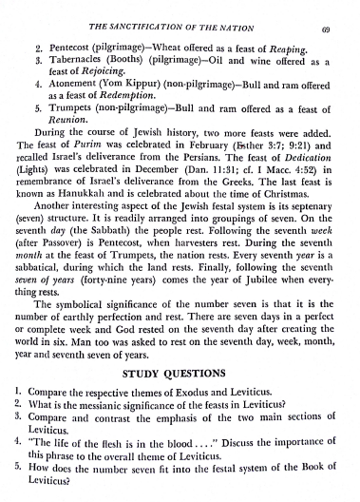

Slide 41
John phillips
A more detailed account of the scripture
30-45 minutes
For the person that wants a deeper, possibly more spiritual experience (sometimes too much)
More application to the believer
More pictures of Christ
The master of alliteration
Helps with understanding and memorization
Good to read before and even better after

Slide 42
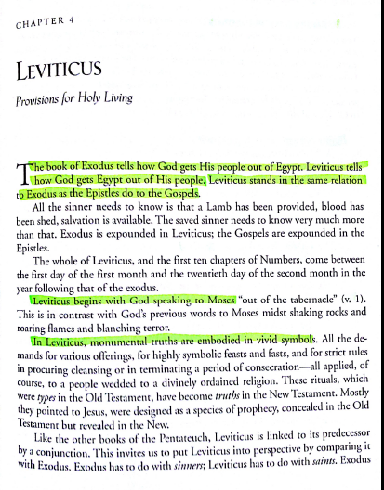

Slide 43
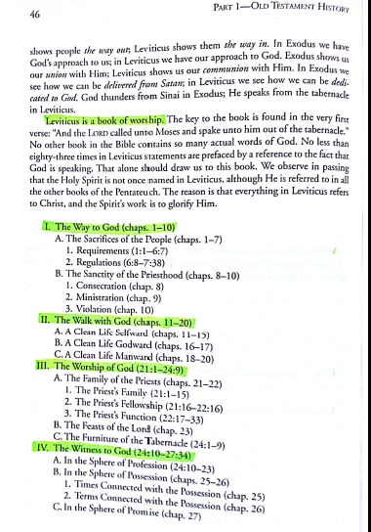

Slide 44
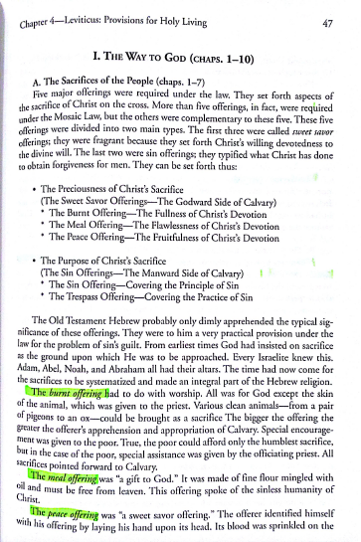

Slide 45
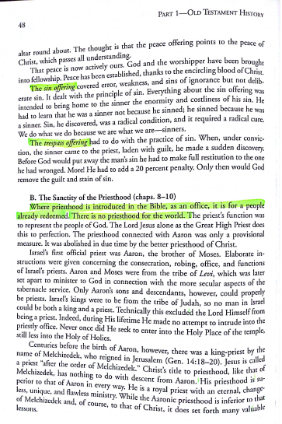

Slide 46
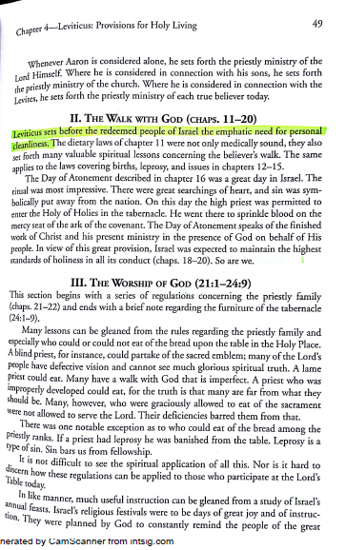

Slide 47
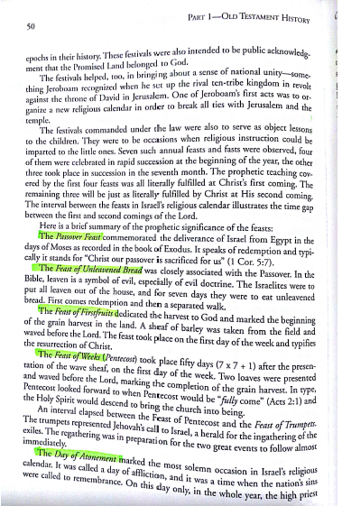

Slide 48
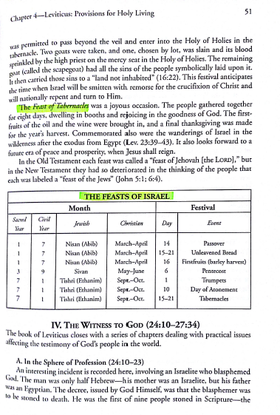

Slide 49
