Slide 1
The Levitical Offerings
(Heb 9:22) And almost all things are by the law purged with blood; and without shedding of blood is no remission.

Slide 2
Before the Law
Cain and Abel both offered sacrifices
(Gen 4:3) And in process of time it came to pass, that Cain brought of the fruit of the ground an offering unto the LORD.
(Gen 4:4) And Abel, he also brought of the firstlings of his flock and of the fat thereof. And the LORD had respect unto Abel and to his offering:
Noah constructed an alter and offered a burnt offering

Slide 3
God Commanded
(Deu 16:16) Three times in a year shall all thy males appear before the LORD thy God in the place which he shall choose; in the feast of unleavened bread, and in the feast of weeks, and in the feast of tabernacles: and they shall not appear before the LORD empty:
(Deu 16:17) Every man shall give as he is able, according to the blessing of the LORD thy God which he hath given thee.

Slide 4
Two Types of Offerings
Non Sweet offerings
Sin offering
Trespass offering
Sweet offerings
Burnt Offering
Peace Offering
Meal Offering

Slide 5
Items Offered
Blood Sacrifices
Oxen, Sheep, Goats, Turtledoves or Young Pigeons
Bloodless Offerings
Grain , Olive Oil, Wine, Salt, and Incense

Slide 6
Method of Sacrifice
(Exo 29:11) And thou shalt kill the bullock before the LORD, by the door of the tabernacle of the congregation.
(Exo 29:12) And thou shalt take of the blood of the bullock, and put it upon the horns of the altar with thy finger, and pour all the blood beside the bottom of the altar.

Slide 7
Five Offerings
Burnt Offering
Peace Offering
Meal Offering
Sin offering
Trespass Offering

Slide 8
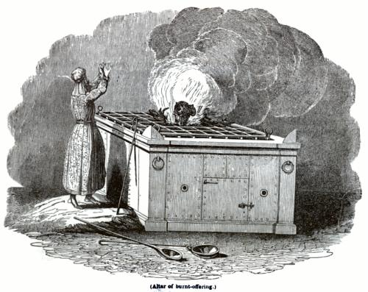
The Burnt Offering

Slide 9
Burnt Offering
(Lev 1:3) If his offering be a burnt sacrifice of the herd, let him offer a male without blemish: he shall offer it of his own voluntary will at the door of the tabernacle of the congregation before the LORD.
(Lev 1:4) And he shall put his hand upon the head of the burnt offering; and it shall be accepted for him to make atonement for him.

Slide 10
Burnt Offering
(Lev 1:5) And he shall kill the bullock before the LORD: and the priests, Aaron's sons, shall bring the blood, and sprinkle the blood round about upon the altar that is by the door of the tabernacle of the congregation.

Slide 11
Typology
(Isa 53:7) He was oppressed, and he was afflicted, yet he opened not his mouth: he is brought as a lamb to the slaughter, and as a sheep before her shearers is dumb, so he openeth not his mouth.
(Heb 10:10) By the which will we are sanctified through the offering of the body of Jesus Christ once for all.

Slide 12
Peace Offering
(Lev 3:1) And if his oblation be a sacrifice of peace offering, if he offer it of the herd; whether it be a male or female, he shall offer it without blemish before the LORD.
(Lev 3:2) And he shall lay his hand upon the head of his offering, and kill it at the door of the tabernacle of the congregation: and Aaron's sons the priests shall sprinkle the blood upon the altar round about.

Slide 13
Typology
(Eph 2:14) For he is our peace, who hath made both one, and hath broken down the middle wall of partition between us;
(Eph 2:15) Having abolished in his flesh the enmity, even the law of commandments contained in ordinances; for to make in himself of twain one new man, so making peace;

Slide 14
Typology
(Eph 2:16) And that he might reconcile both unto God in one body by the cross, having slain the enmity thereby:
(Eph 2:17) And came and preached peace to you which were afar off, and to them that were nigh.
(Eph 2:18) For through him we both have access by one Spirit unto the Father.

Slide 15
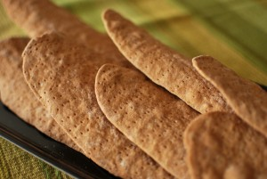
Meal Offering

Slide 16
Meal Offering
(Lev 2:1) And when any will offer a meat offering unto the LORD, his offering shall be of fine flour; and he shall pour oil upon it, and put frankincense thereon:
(Lev 2:2) And he shall bring it to Aaron's sons the priests: and he shall take thereout his handful of the flour thereof, and of the oil thereof, with all the frankincense thereof; and the priest shall burn the memorial of it upon the altar, to be an offering made by fire, of a sweet savour unto the LORD:

Slide 17
Typology
Leaven - (1Co 5:7) Purge out therefore the old leaven, that ye may be a new lump, as ye are unleavened. For even Christ our passover is sacrificed for us:
Oil - (Exo 40:9) And thou shalt take the anointing oil, and anoint the tabernacle, and all that is therein, and shalt hallow it, and all the vessels thereof: and it shall be holy.
(Act 10:38) How God anointed Jesus of Nazareth with the Holy Ghost and with power: who went about doing good, and healing all that were oppressed of the devil; for God was with him.

Slide 18
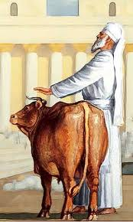
Sin Offering

Slide 19
Sin Offering
(Lev 4:1) And the LORD spake unto Moses, saying,
(Lev 4:2) Speak unto the children of Israel, saying, If a soul shall sin through ignorance against any of the commandments of the LORD concerning things which ought not to be done, and shall do against any of them:

Slide 20
Sin Offering
(Lev 4:3) If the priest that is anointed do sin according to the sin of the people; then let him bring for his sin, which he hath sinned, a young bullock without blemish unto the LORD for a sin offering.

Slide 21
Typology
(Heb 13:11) For the bodies of those beasts, whose blood is brought into the sanctuary by the high priest for sin, are burned without the camp.
(Heb 13:12) Wherefore Jesus also, that he might sanctify the people with his own blood, suffered without the gate.

Slide 22
Typology
(Isa 53:5) But he was wounded for our transgressions, he was bruised for our iniquities: the chastisement of our peace was upon him; and with his stripes we are healed.
(Isa 53:6) All we like sheep have gone astray; we have turned every one to his own way; and the LORD hath laid on him the iniquity of us all.

Slide 23
Typology
(Isa 53:7) He was oppressed, and he was afflicted, yet he opened not his mouth: he is brought as a lamb to the slaughter, and as a sheep before her shearers is dumb, so he openeth not his mouth.

Slide 24
Trespass Offering
(Lev 5:14) And the LORD spake unto Moses, saying,
(Lev 5:15) If a soul commit a trespass, and sin through ignorance, in the holy things of the LORD; then he shall bring for his trespass unto the LORD a ram without blemish out of the flocks, with thy estimation by shekels of silver, after the shekel of the sanctuary, for a trespass offering:

Slide 25
Trespass Offering
(Lev 5:16) And he shall make amends for the harm that he hath done in the holy thing, and shall add the fifth part thereto, and give it unto the priest: and the priest shall make an atonement for him with the ram of the trespass offering, and it shall be forgiven him.

Slide 26
Typology
(Psa 51:4) Against thee, thee only, have I sinned, and done this evil in thy sight: that thou mightest be justified when thou speakest, and be clear when thou judgest.

