Slide 1
Esther
God’s Providence

Slide 2
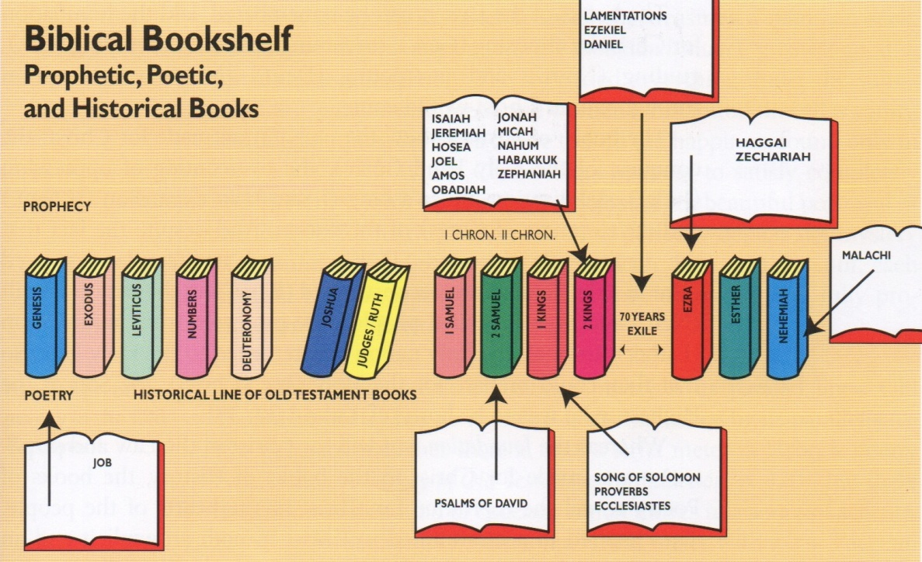
The Bibliographical Sketch

Slide 3
God Hidden In The Exile
One of the only two books in the bible named after women
Ruth was a Gentile married to a Jew and Esther a Jew married to a Gentile
No mention is made of Palestine, Jerusalem, the temple, the law, or general Hebrew history
And most significantly God is not mentioned once
So we do not see the presence of God anywhere in the book of Esther

Slide 4
God Hidden In The Exile
But the Persian King is mentioned 192 times in 167 verses
His kingdom is referred to 26 times
God warned his people that if they forsook Him, He would hide his face from them (Duet. 31:17)
(Deu 31:17) Then my anger shall be kindled against them in that day, and I will forsake them, and I will hide my face from them, and they shall be devoured, and many evils and troubles shall befall them; so that they will say in that day, Are not these evils come upon us, because our God is not among us?

Slide 5
God Hidden In The Exile
(Deu 31:18) And I will surely hide my face in that day for all the evils which they shall have wrought, in that they are turned unto other gods.
This is part of the fulfilling of this promise
Satan was at work, through a man named Haman, to exterminate God’s chosen people
But God was secretly at work to help His people and is hidden throughout the whole book

Slide 6
God’s People Comfortable
50 years earlier King Cyrus aloud the remnant to return to Jerusalem
Fulfillment of prophecy (Isa. 44, Jer. 25 & 29)
Only about 50,000 then and about 600 in Ezra’s time
Most of these captives would have been born in Babylon
They were settled, accepted, and influential
And very few wanted to pioneer a work of God and return to their land

Slide 7
God’s People Threatened
The Book describes a crisis in the history of the Hebrew people in the day of Xerxes
Xerxes (Ahasuerus) is known as a tyrannical, mean tempered, ruthless ruler
The Jews were being threatened with total extermination because of one man, Haman, The chief minister of state
Haman got mad because Mordecai refused to bow to him

Slide 8
God’s People Threatened
Haman plotted a public execution of Mordecai on a special gallows and then decided to destroy all of his people as well
Men have tried to stamp out God’s people for centuries (Pharaoh, Hitler, Saddam)
“But God has His hand upon the Jewish people, and He has His own high purpose to work out with them”
The gentiles will never eradicate the Jews
“In Esther there are no miraculous interventions” just God behind the scene foiling the plans of Satan

Slide 9
Main Characters
Just like in the book of Exodus and Ruth we see a hidden message of Salvation
We see this through the main characters
King – represents the unsaved man, ignorant of God, motivated and controlled by worldly principles
Modecai – provides salvation and therefore represents the Savior
Haman – is the villain who represents the devil
Esther – knows and loves Mordecai (Savior) and bears witness of the truth to her husband (King)

Slide 10
Main Characters
But to learn the spiritual lesson of the book we will look at an outline that emphasizes the King
“the book opens with the king, who is ignorant of God and His salvation. He struggles as God deals with His heart, finally surrenders, hands everything over to Mordecai the savior, and thereafter brings blessings to others”
Thank God for the day I finally surrendered to God
I am thankful he was working behind the scenes

Slide 11
The Outline
The King as a Resentful Man (Ch.1-3)
His Sinful Ways, Second Wife, and Stubborn Will
The King as a Restless Man (Ch.4-6)
The Lord Arrested the Silent Believer and Aroused the Sinful Unbeliever
The King as a Responsive Man (Ch.7-10)
A Monumental Fall, Manifest Faith, Marvelous Future, Memorial Feast

Slide 12
I. The King as a Resentful Man
His Sinful Ways (Ch.1)
He had just suffered 2 defeats
The navy was sunk at Salamis
The Greeks decimated their armies at Thermopylae
The disappointed King had a 6 month feast
It was done to show his “pomp and power” after such a great military loss
After a week of drinking and partying he decided that he is going to show off his wife
King commanded his wife, Vashti, to come before the king to “shew the people and the princes her beauty”

Slide 13
I. The King as a Resentful Man
(Est 1:10) On the seventh day, when the heart of the king was merry with wine, he commanded Mehuman, Biztha, Harbona, Bigtha, and Abagtha, Zethar, and Carcas, the seven chamberlains that served in the presence of Ahasuerus the king,(Est 1:11) To bring Vashti the queen before the king with the crown royal, to shew the people and the princes her beauty: for she was fair to look on.
In an amazing act of courage she refuses and he divorces her

Slide 14
I. The King as a Resentful Man
His Second Wife (Ch.2)
A Beauty contest was held throughout the Persian Empire
(Est 2:3) And let the king appoint officers in all the provinces of his kingdom, that they may gather together all the fair young virgins unto Shushan the palace, to the house of the women, unto the custody of Hege the king's chamberlain, keeper of the women; and let their things for purification be given them:
(Est 2:4) And let the maiden which pleaseth the king be queen instead of Vashti. And the thing pleased the king; and he did so.

Slide 15
I. The King as a Resentful Man
“we are not told how Esther, a lovely Jewess, got caught up in all this. Perhaps she had no choice. But she won the contest and became the King’s new wife and Persia’s queen”
Mordecai is introduced – Esther’s older cousin who adopted her into his family after she was orphaned
Mordecai heard of a plot against the king’s life and told Esther who then told the king and the assassins where caught and hanged
Esther told him that Mordecai was the man who saved him but he ignored that part and does not know who had provided him salvation

Slide 16
I. The King as a Resentful Man
His Stubborn Will (Ch.3)
As soon as he ignored the message of salvation Haman is introduced
(Est 3:1) After these things did king Ahasuerus promote Haman the son of Hammedatha the Agagite, and advanced him, and set his seat above all the princes that were with him.
A Jew had provided salvation, he ignored it, and Satan attacked afterwards

Slide 17
I. The King as a Resentful Man
He went from bad to worse committing his worst act of sin
He signed the decree to exterminate the Jews for Haman
“Often those who receive a witness of salvation do not respond immediately. Indeed, instead of responding, thy sometimes go from bad to worse, and the enemy gains a greater power over them than before”

Slide 18
II. The King as a Restless Man
How the Lord Arrested the Silent Believer (Ch.4-5)
The king became restless because God had began to deal with him although he didn’t know it
“that great moment of awakening in the soul of Esther’s husband could not come until something was done in her own heart. For too long she had been content to be a silent believer.”

Slide 19
II. The King as a Restless Man
Esther had been silent about Haman and her husband’s treatment of her people knowing she may be the only one that could stop it
(Est 4:1) When Mordecai perceived all that was done, Mordecai rent his clothes, and put on sackcloth with ashes, and went out into the midst of the city, and cried with a loud and a bitter cry;
Esther heard about it and sent him raiment and he turned it away

Slide 20
II. The King as a Restless Man
“Esther did what many do when faced with conviction – she tried to silence the convicting voice by giving Mordecai a gift. How often we seek to hush our conscience by giving a large donation to the Lord’s work”
(Est 4:13) Then Mordecai commanded to answer Esther, Think not with thyself that thou shalt escape in the king's house, more than all the Jews.

Slide 21
II. The King as a Restless Man
Esther agreed to confront the king and asked that God’s people pray and fast
She knew that prayer and fasting had power
(Est 4:16) Go, gather together all the Jews that are present in Shushan, and fast ye for me, and neither eat nor drink three days, night or day: I also and my maidens will fast likewise; and so will I go in unto the king, which is not according to the law: and if I perish, I perish.
“God wouldn’t do anything about the rebellion in her husband’s heart until he did something about hers”

Slide 22
II. The King as a Restless Man
How the Lord Aroused the Sinful Unbeliever (Ch.6)
The removal of disobedience in Esther’s heart cleared the way for God to act in her husbands
That very night the King couldn’t sleep
He commanded the court librarian to read to him
He read the “book of the records of the chronicles”
He read the story of how it was Mordecai that foiled the assassination attempt

Slide 23
II. The King as a Restless Man
The work of salvation that Mordecai provided had not been forgotten
It had been recorded
“we see two unsaved men sitting up and one man reading the other man of a savior and of a salvation provided for him”
Conviction set in. All this time he had been ignorant of the salvation provided by Mordecai

Slide 24
II. The King as a Restless Man
And he realized he had not done anything to acknowledge his debt to the one that provided salvation for him
and as soon as he was getting ready to Hamman reappears
“at the critical moment that he was going to make his decision public the enemy came”
Every time you tell somebody about Jesus the devil with rear His ugly head

Slide 25
II. The King as a Restless Man
But he was too late because the king had already made up his mind and God used Haman’s intrusion to magnify the savior
“The king knew that he must publically confess his indebtedness to his savior and exalt that one by placing him over all his affairs”
And he clothes Mordecai in royal apparel and honors him in the streets of the city

Slide 26
III. The King as a Responsive Man
A Monumental Fall (Ch.7)
Esther’s task was now to reveal to her changed husband who the enemy was and how the enemy had been using and manipulating him
Haman was exposed – his hatred towards Mordecai and his people was shown to the king
Haman was executed – hung from the gallows prepared by him for Mordecai, along with his sons

Slide 27
III. The King as a Responsive Man
A Manifest Faith (Ch.8)
(Est 8:2) And the king took off his ring, which he had taken from Haman, and gave it unto Mordecai. And Esther set Mordecai over the house of Haman.
“Where once the enemy had ruled now the savior ruled”
People noticed there was a difference
“The kingdom knew at once that there had been a dramatic change of management in the king’s affairs”

Slide 28
III. The King as a Responsive Man
A Marvelous Future (Ch.9)
(Est 8:17) And in every province, and in every city, whithersoever the king's commandment and his decree came, the Jews had joy and gladness, a feast and a good day. And many of the people of the land became Jews; for the fear of the Jews fell upon them.

Slide 29
III. The King as a Responsive Man
A Memorial Feast (Ch9-10)
God did not want the great work of the savior to be forgotten so a feast of remembrance was instituted
“God wants us to never forget what He has done for us and what we owe to our Savior”
That is why we do the Lord’s Supper
What a wonderful picture of salvation in the book of Esther
And had Esther not told the King about the Savior all the Jews would have died

Slide 30
Esther
For Such A Time As This

Slide 31
III. The King as a Responsive Man
A Memorial Feast (Ch9-10)
God did not want the great work of the savior to be forgotten so a feast of remembrance was instituted
“God wants us to never forget what He has done for us and what we owe to our Savior”
That is why we do the Lord’s Supper
What a wonderful picture of salvation in the book of Esther
And had Esther not told the King about the Savior all the Jews would have died

Slide 32
We Employ Excuses
(Est 4:11) All the king's servants, and the people of the king's provinces, do know, that whosoever, whether man or woman, shall come unto the king into the inner court, who is not called, there is one law of his to put him to death, except such to whom the king shall hold out the golden sceptre, that he may live: but I have not been called to come in unto the king these thirty days.

Slide 33
We Engage in Egotism
(Est 4:12) And they told to Mordecai Esther's words.
(Est 4:13) Then Mordecai commanded to answer Esther, Think not with thyself that thou shalt escape in the king's house, more than all the Jews.

Slide 34
We Eliminate The Endeavor
(Est 4:14) For if thou altogether holdest thy peace at this time, then shall there enlargement and deliverance arise to the Jews from another place; but thou and thy father's house shall be destroyed: and who knoweth whether thou art come to the kingdom for such a time as this?

Slide 35
For Such A Time As This
(Est 4:16) Go, gather together all the Jews that are present in Shushan, and fast ye for me, and neither eat nor drink three days, night or day: I also and my maidens will fast likewise; and so will I go in unto the king, which is not according to the law: and if I perish, I perish.

