Slide 1
Lamentations
The Story of The Prodigal City

Slide 2
Facts About Lamentations
The definition of the word lamentation is a “passionate expression of grief or sorrow; weeping”
The book is a lamentation over the destruction of the city of Jerusalem and the temple of God
Lamentations is1st of 3 exilic books along with Ezekiel and Daniel
Lamentations look’s in the past where as the other 2 exilic books look to the future

Slide 3
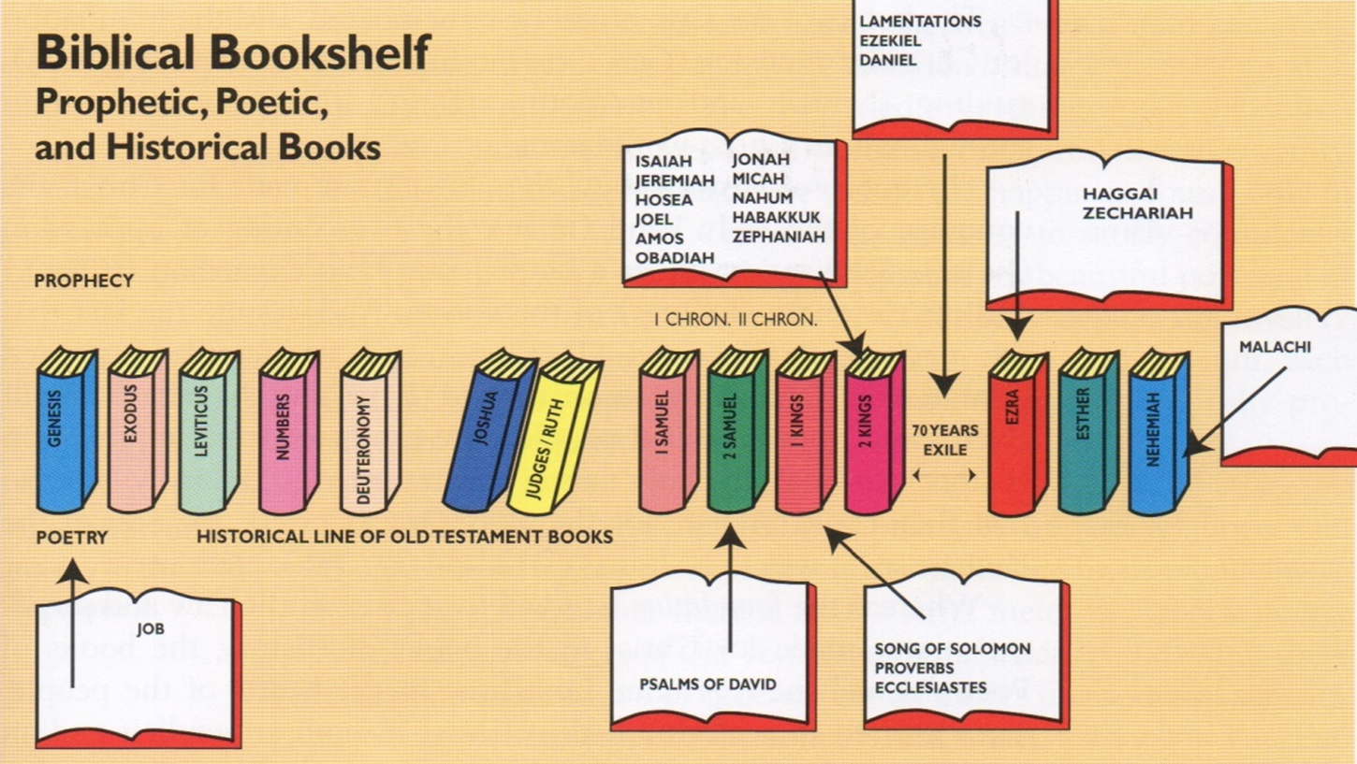

Slide 4
Facts About Lamentations
The prophetic books mostly look to the future but Lamentations is included in this section due to its immediate connection with Jeremiah
It is truly a poetic book with every chapter having a Hebraic poetic form
Jeremiah was the author of the entire book
It was written by Jeremiah immediately after the fall of Jerusalem

Slide 5
Facts About Lamentations
It was written to the exiled Jewish nation whose land had been captured by the Babylonians and who's temple had just been burned
3 reasons Lamentations was written
  The Historical Purpose
    A expression of sorrow at the destruction of Jerusalem and a reminder of God’s faithfulness to His word and His people
  The Doctrinal Purpose
    “an unusual but compatible mix of the wrath and mercy of God. It stresses His faithfulness to His promise to punish evil and yet His steadfast love and compassion for His people”

Slide 6
Facts About Lamentations
  The Christological Purpose
    There are several pictures of Christ
      The affliction of the Lord (1:12)
(Lam 1:12) Is it nothing to you, all ye that pass by? behold, and see if there be any sorrow like unto my sorrow, which is done unto me, wherewith the LORD hath afflicted me in the day of his fierce anger.

Slide 7
Facts About Lamentations
      Despised of his enemies (2:15-16)
(Lam 2:15) All that pass by clap their hands at thee; they hiss and wag their head at the daughter of Jerusalem, saying, Is this the city that men call The perfection of beauty, The joy of the whole earth?
(Lam 2:16) All thine enemies have opened their mouth against thee: they hiss and gnash the teeth: they say, We have swallowed her up: certainly this is the day that we looked for; we have found, we have seen it.

Slide 8
Facts About Lamentations
      The smitten and insulted one (3:16)
(Lam 3:16) He hath also broken my teeth with gravel stones, he hath covered me with ashes.
Lamentations is in the form of an acrostic dirge and consist of 5 poems
A dirge is a somber song or lament expressing mourning or grief, such as would be appropriate for performance at a funeral
Read at the feast of Ab: commemorates the destruction of Israel

Slide 9
Facts About Lamentations
Synonyms - elegy, lament, burial hymn
The dirge speaks of the fall of Jerusalem and the sufferings the resulted from it
Jeremiah and Jesus both wept over Jerusalem
  “O Jerusalem, Jerusalem”
They even thought Jesus was Jeremiah risen from the dead
  (Mat 16:14) And they said, Some say that thou art John the Baptist: some, Elias; and others, Jeremias, or one of the prophets.

Slide 10
Acrostic Poetry
A form of writing in which the first letter, syllable or word of each line, paragraph or other recurring feature in the text spells out a word or a message
An acrostic can be used as a mnemonic device to aid memory retrieval
A famous acrostic was made in Greek for the acclamation JESUS CHRIST, SON OF GOD, SAVIOUR
The initials spell ICHTHYS (ΙΧΘΥΣ), Greek for fish

Slide 11
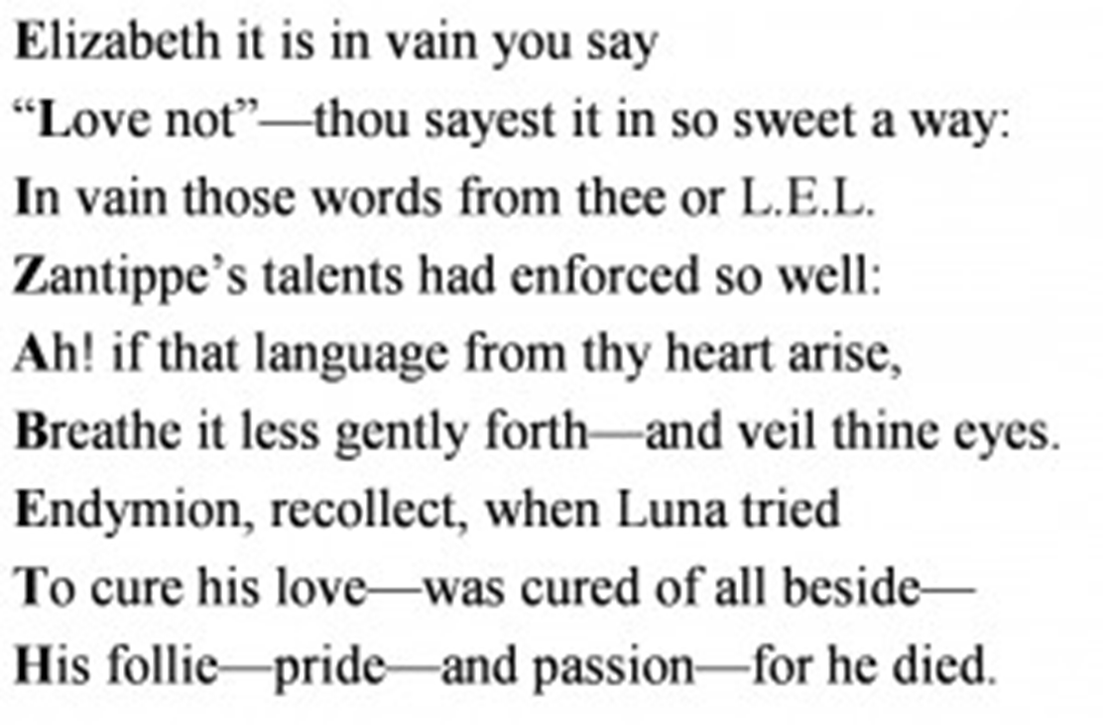
Acrostic Poetry

Slide 12
Acrostic Poetry
Examples of Acrostics in the Bible
  Proverbs 31, 10-31
  Psalms 9, 10, 25, 34, 37, 111, 112, 119 and 145
The acrostic format was used by the author, inspired by God, to aid in the memory of the scriptures
The Jews carried much of their history and their heritage in their minds
Rabbis memorized the Talmud – central text – the oral law, and other scripture like the Old Testament

Slide 13
Lamentations Acrostic Format
1st, 2nd, 4th and 5th are all 22 verses with each verse corresponding to the letters of the Hebrew alphabet (excluding the 5th)
3rd is 66 verses, written in triplet format, with 3 verses corresponding to each letter
The 5th is a prayer

Slide 14
Outline
“Written in the rhythm of a funeral dirge, the book laments, in the form of 5 metaphors, the downfall of Zion, the city of God”
The Pain of Zion’s Fall – A mourning widow
The Plight of Zion’s Fall – a weeping daughter
The Purpose of Zion’s Fall – an afflicted man
Pondering Zion’s Fall – tarnished gold
Plea on behalf of Zion’s fall – a fatherless child

Slide 15
The Pain of Zion’s Fall – A mourning widow
We see a pathetic description of the fallen city (1:1-11)
  (Lam 1:1) How doth the city sit solitary, that was full of people! how is she become as a widow! she that was great among the nations, and princess among the provinces, how is she become tributary!
The national desperation is described (1:12-22)
  (Lam 1:12) Is it nothing to you, all ye that pass by? behold, and see if there be any sorrow like unto my sorrow, which is done unto me, wherewith the LORD hath afflicted me in the day of his fierce anger.

Slide 16
The Plight of Zion’s Fall – a weeping daughter
What God did to Zion is depicted (2:1-10)
  (Lam 2:1) How hath the Lord covered the daughter of Zion with a cloud in his anger, and cast down from heaven unto the earth the beauty of Israel, and remembered not his footstool in the day of his anger!
Why God did it
  (Lam 2:17) The LORD hath done that which he had devised; he hath fulfilled his word that he had commanded in the days of old…
  (Lam 2:15) All that pass by clap their hands at thee; they hiss and wag their head at the daughter of Jerusalem, saying, Is this the city that men call The perfection of beauty, The joy of the whole earth?

Slide 17
The Purpose of Zion’s Fall – an afflicted man
Jerusalem is depicted as a man under God’s wrath
  (Lam 3:1) I am the man that hath seen affliction by the rod of his wrath.
The prophet took comfort is Jerusalem's calamity (3:1-39)
  (Lam 3:22) It is of the LORD'S mercies that we are not consumed, because his compassions fail not.
  (Lam 3:23) They are new every morning: great is thy faithfulness.
Assured that the Lord would not cast him offer forever he asked
  (Lam 3:39) Wherefore doth a living man complain, a man for the punishment of his sins?

Slide 18
The Purpose of Zion’s Fall – an afflicted man
Thus he received confidence through confession (3:40-66)
  (Lam 3:39) Wherefore doth a living man complain, a man for the punishment of his sins?
  (Lam 3:40) Let us search and try our ways, and turn again to the LORD.
  Lam 3:41 Let us lift up our heart with our hands unto God in the heavens.
  Lam 3:42 We have transgressed and have rebelled: thou hast not pardoned.

Slide 19
Pondering Zion’s Fall – tarnished gold
(Lam 4:1) How is the gold become dim! how is the most fine gold changed! the stones of the sanctuary are poured out in the top of every street.
Jeremiah described their present punishment (4:1-15)
  (Lam 4:6) For the punishment of the iniquity of the daughter of my people is greater than the punishment of the sin of Sodom, that was overthrown as in a moment, and no hands stayed on her.
  (Lam 4:10) The hands of the pitiful women have sodden their own children: they were their meat in the destruction of the daughter of my people.

Slide 20
Pondering Zion’s Fall – tarnished gold
The future prospect seemed very dim (4;16-22)
  (Lam 4:16) The anger of the LORD hath divided them; he will no more regard them: they respected not the persons of the priests, they favoured not the elders.
  (Lam 4:22) The punishment of thine iniquity is accomplished, O daughter of Zion; he will no more carry thee away into captivity: he will visit thine iniquity, O daughter of Edom; he will discover thy sins.

Slide 21
Plea on behalf of Zion’s fall – a fatherless child
Zion is pictured as an orphaned child (5:1-18)
  (Lam 5:1) Remember, O LORD, what is come upon us: consider, and behold our reproach.
  (Lam 5:3) We are orphans and fatherless, our mothers are as widows.
  (Lam 5:11) They ravished the women in Zion, and the maids in the cities of Judah.
  (Lam 5:12) Princes are hanged up by their hand: the faces of elders were not honoured.

Slide 22
Plea on behalf of Zion’s fall – a fatherless child
The cause is pleaded (5:19-22)
  (Lam 5:19) Thou, O LORD, remainest for ever; thy throne from generation to generation.
  (Lam 5:20) Wherefore dost thou forget us for ever, and forsake us so long time?
  (Lam 5:21) Turn thou us unto thee, O LORD, and we shall be turned; renew our days as of old.
  (Lam 5:22) But thou hast utterly rejected us; thou art very wroth against us.

Slide 23
Getting out of babylon

