Slide 1
The Prophets
Men Sent From God

Slide 2
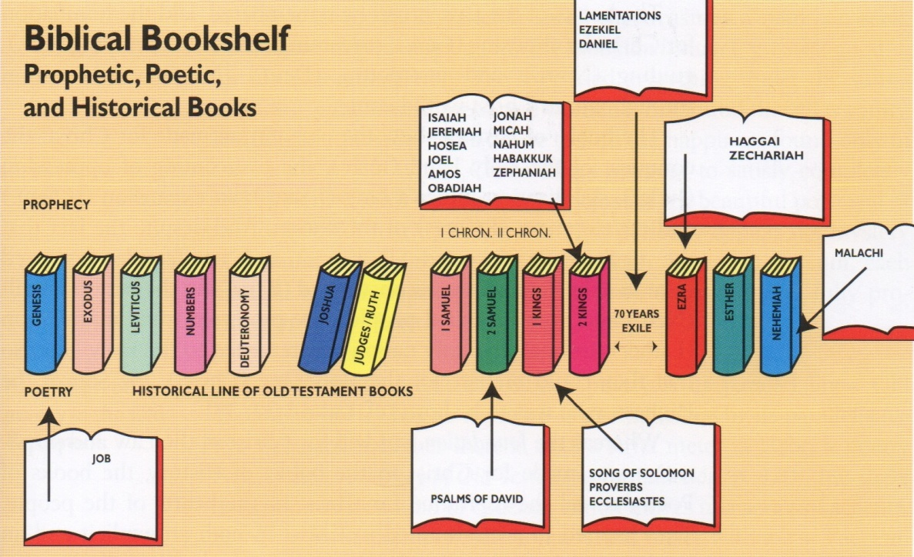
2. The Bibliographical Sketch

Slide 3
Meaning of Prophecy
Meaning – comes from the word meaning “to announce”
God’s mouthpiece
Broad meaning is to forth-tell (used bible/today)
Narrow meaning is to fore-tell (used Bible)
In forth-telling Gods’ message to his day the prophet would often foretell what God was going to do in the future
These supernatural predictions are some of the strongest evidence that the Bible is the Word of God

Slide 4
Meaning of Prophecy
Forth-telling involved insight into the will of God
Forth-telling is exhortive – challenging men to higher moral conduct
Fore-telling involved foresight into the plan of God
Fore-telling is predictive, encouraging the righteous

Slide 5
Meaning of Prophecy
A prophets job is not just to foretell the future but he is also a man with a message from God to his own generation, a “forthteller”
The appearance of a prophet was always a sign that apostasy and rebellion were predominant in Israel
Sometimes he did not understand his own utterances
Primarily focus on 2 events – 1st and 2nd comings of Christ

Slide 6
Background of Prophecy
Political and religious conditions are constantly reflected in the writings of the prophets
The books of prophecy can be better understood if aware of these conditions
They are mostly concerned with the empires of Egypt, Assyria, Babylon, and Persia
Assyria and Babylon ended the monarchies of Israel and Judah
Persia brought about the restoration of the Jews to their homeland

Slide 8
Assyria
From the reign of Sennacherib on, Nineveh was the capital city of the Assyrian Empire
They were extremely cruel
They inflicted torture on the people they conquered
They would uproot entire populations and deport them to remote parts of the empire
The leading men of the conquered lands were tortured and mutilated and then put to death

Slide 9
Isaiah
The Evangelical Prophet

Slide 10
Interesting Facts
“Isaiah lived through a stormy era”
He lived to see his sister kingdom of Israel over-thrown by the Assyrians
Amos and Hosea had proceeded him giving warning to the northern 10 tribes
In later years Micah joined him in preaching against the sin and follies of Judah
He prophesied through the reigns of 4 of Judah's Kings and was martyred in the reign of the 5th
“during the days of Isaiah the great Assyrian Empire dominated the stage of history”

Slide 11
Interesting Facts
Many of Isaiah’s prophecies were to warn the surrounding nations what to expect at the hands of the Assyrian’s
During the Assyrian’s reign Isaiah prophesied of the Babylonians who would come later and defeat Judah
Assyria came in and captured Samaria, capital of Israel, and deported 2/3rd of the Jews
After several attempted alliances by Judah the Assyrian's then infiltrated Judah
It is against this background that much Isaiah’s prophecy comes

Slide 12
Interesting Facts
It is one of the most often quoted books in NT
The name Isaiah means “Jehovah is salvation”
Isaiah 53 is what Philip the evangelist used to lead the Ethiopian to the Lord
(Act 8:32) The place of the scripture which he read was this, He was led as a sheep to the slaughter; and like a lamb dumb before his shearer, so opened he not his mouth:

Slide 13
Interesting Facts
Isaiah is like a miniature Bible
66 chapters and 66 books
The 1st 39 chapters correspond to the OT and speak largely of Israel before the coming Messiah
The last 27 speak largely about the messiah and His coming Kingdom
It is a beautiful picture of the entire bible

Slide 14
Interesting Facts
Isaiah is the author if his book
“he was no doubt the greatest of the writing prophets both in the extent and comprehensiveness of his message and in his ability to communicate”
Isaiah prophesied mostly to the southern kingdom of Judah
he was sent of God to warn Judah of the sins that lead to Israel's downfall
“He is warning them that God will bring condemnation on their nations through other nations but that God will provide salvation through Israel and Judah to other nations”

Slide 15
Interesting Facts
“Isaiah is the most complete and comprehensive description of Christ found in the OT”
(Isa 6:1) In the year that king Uzziah died I saw also the Lord sitting upon a throne, high and lifted up, and his train filled the temple.
(Isa 7:14) Therefore the Lord himself shall give you a sign; Behold, a virgin shall conceive, and bear a son, and shall call his name Immanuel.

Slide 16
Interesting Facts
(Isa 9:6) For unto us a child is born, unto us a son is given: and the government shall be upon his shoulder: and his name shall be called Wonderful, Counsellor, The mighty God, The everlasting Father, The Prince of Peace.
(Isa 11:1) And there shall come forth a rod out of the stem of Jesse, and a Branch shall grow out of his roots:
(Isa 11:2) And the spirit of the LORD shall rest upon him, the spirit of wisdom and understanding, the spirit of counsel and might, the spirit of knowledge and of the fear of the LORD;

Slide 17
Interesting Facts
(Isa 43:14) Thus saith the LORD, your redeemer, the Holy One of Israel; For your sake I have sent to Babylon, and have brought down all their nobles, and the Chaldeans, whose cry is in the ships.
(Isa 61:1) The Spirit of the Lord GOD is upon me; because the LORD hath anointed me to preach good tidings unto the meek; he hath sent me to bind up the brokenhearted, to proclaim liberty to the captives, and the opening of the prison to them that are bound;

Slide 18
Outline
3 main divisions – 2 prophetical and 1 historical
Isaiah’s Predictive Statements (Ch.1-35)
Isaiah’s Practical Statesmanship (Ch.36-39)
Isaiah’s Prophetic Stature (40-66)

Slide 19
Isaiah’s Predictive Statements (Ch.1-35)
Most of the prophecies in this section are arranged chronologically
He goes down the list of most of the kings during the time in which he prophesied
In the year that king Uzziah died…(6:1)
In the days of Ahaz…(7:1)
In the year that king Ahaz died…(14:28)
In the year that Tartan came unto Ashdod, (when Sargon the king of Assyria sent him,)…(20:1)
In the fourteenth year of king Hezzekiah…(36:1)

Slide 20
Isaiah’s Predictive Statements (Ch.1-35)
In Isaiah's day the religious climate was deceptive
People were attending the place of worship but the numbers were deceptive
“as we check off the list of national inconsistencies, we can think of the condition in the US and the west today”
Isaiah immediately strips away the outward façade to show their insides
(Isa 1:2) Hear, O heavens, and give ear, O earth: for the LORD hath spoken, I have nourished and brought up children, and they have rebelled against me.

Slide 21
Isaiah’s Predictive Statements (Ch.1-35)
“he hammers away at the basic truth that a living, meaningful, dynamic faith in God is a nation’s only hope for a healthy society and defense from the enemy”
Spiritism had become a national danger and Isaiah warns against the “soothsayers”
That is your modern day psychics
(Isa 2:6) Therefore thou hast forsaken thy people the house of Jacob, because they be replenished from the east, and are soothsayers like the Philistines, and they please themselves in the children of strangers.

Slide 22
Isaiah’s Predictive Statements (Ch.1-35)
Materialism was destroying the nation as well
(Isa 2:7) Their land also is full of silver and gold, neither is there any end of their treasures; their land is also full of horses, neither is there any end of their chariots:
“when a country becomes prosperous it usually becomes complacent and independent of God”
If that is not true of America I don’t know what it

Slide 23
Isaiah’s Predictive Statements (Ch.1-35)
The worship of idols
(Isa 2:8) Their land also is full of idols; they worship the work of their own hands, that which their own fingers have made:
They trusted their military more than God
(Isa 2:7) Their land also is full of silver and gold, neither is there any end of their treasures; their land is also full of horses, neither is there any end of their chariots:

Slide 24
Isaiah’s Predictive Statements (Ch.1-35)
And the leading men became very wicked and corrupt – Drain the swamp
All this wickedness and the fact that Assyria was right next door was not good for Judah
Isaiah is convinced now that God is going to judge them by an armed invasion
And he begins to pronounce “woes” on the nation

Slide 25
Isaiah’s Predictive Statements (Ch.1-35)
Woe to the slumlord
(Isa 5:8) Woe unto them that join house to house, that lay field to field, till there be no place, that they may be placed alone in the midst of the earth!
“this was the kind of man who, in the city, was building what we would call tenement property and exploiting the poor”

Slide 26
Isaiah’s Predictive Statements (Ch.1-35)
Woe to the giddy playboy
(Isa 5:11) Woe unto them that rise up early in the morning, that they may follow strong drink; that continue until night, till wine inflame them!
“this was the kind of person, from morning to night, had only one thought – to wring as much pleasure as he could out of every moment”

Slide 27
Isaiah’s Predictive Statements (Ch.1-35)
Woe to the syndicated crime
(Isa 5:18) Woe unto them that draw iniquity with cords of vanity, and sin as it were with a cart rope:(Isa 5:19) That say, Let him make speed, and hasten his work, that we may see it: and let the counsel of the Holy One of Israel draw nigh and come, that we may know it!
“this was the man who made a vice profession and whose whole life was the professional exploitation of sin”

Slide 28
Isaiah’s Predictive Statements (Ch.1-35)
Woe to the humanist
(Isa 5:20) Woe unto them that call evil good, and good evil; that put darkness for light, and light for darkness; that put bitter for sweet, and sweet for bitter!
“this kind of people tells us that an alcoholic is sick and that a homosexual simply has an alternative lifestyle…(they) excuse criminal behavior, blaming society for the lawless behavior of criminals”

Slide 29
Isaiah’s Predictive Statements (Ch.1-35)
Woe to the conceited philosopher
(Isa 5:21) Woe unto them that are wise in their own eyes, and prudent in their own sight!
“this is the person who is wise in his own eyes and prudent in his own sight”
Bill Nye

Slide 30
Isaiah’s Predictive Statements (Ch.1-35)
Woe to the besotted judge
(Isa 5:22) Woe unto them that are mighty to drink wine, and men of strength to mingle strong drink:
(Isa 5:23) Which justify the wicked for reward, and take away the righteousness of the righteous from him!
This was the man who was not only a habitual drunk but also an evil judge who justified the wicked for reward

Slide 31
Isaiah’s Predictive Statements (Ch.1-35)
These different sins made judgment inevitable for Judah
“but ever and again he lifted up his eyes and looked far down the ages unborn”
He saw past the rise and fall Assyria, Babylon, Persia, Greece, and Rome and he saw God’s son arrive on the scene

Slide 32
Isaiah’s Predictive Statements (Ch.1-35)
(Isa 11:1) And there shall come forth a rod out of the stem of Jesse, and a Branch shall grow out of his roots:
(Isa 11:2) And the spirit of the LORD shall rest upon him, the spirit of wisdom and understanding, the spirit of counsel and might, the spirit of knowledge and of the fear of the LORD;
Jesus always has and always will be the answer

Slide 33
Isaiah’s Predictive Statements (Ch.1-35)
In that same chapter he sees the Jews scattered throughout the Earth
And he saw Israel regathered
(Isa 11:11) And it shall come to pass in that day, that the Lord shall set his hand again the second time to recover the remnant of his people…
(Isa 11:12) And he shall set up an ensign for the nations, and shall assemble the outcasts of Israel, and gather together the dispersed of Judah from the four corners of the earth.
He saw what we see today!!!

Slide 34
Isaiah’s Predictive Statements (Ch.1-35)
When he wrote that the nations of Israel and Judah were still intact – neither displaced
He then sees even further down the road
There are 3 comings of the nation of Israel into the promised land
Came from Egypt – gave us the bible
Came from Babylon – gave us the savior
The third time – they will give us the millennium
“after the purging of the nation in the fires of the great tribulation”

Slide 35
Isaiah’s Predictive Statements (Ch.1-35)
(Isa 11:6) The wolf also shall dwell with the lamb, and the leopard shall lie down with the kid; and the calf and the young lion and the fatling together; and a little child shall lead them.
(Isa 11:7) And the cow and the bear shall feed; their young ones shall lie down together: and the lion shall eat straw like the ox.

Slide 36
Isaiah’s Practical Statesmanship (Ch.36-39)
Sennacherib had taken the Assyrian throne and had sent a large detachment against Jerusalem with a letter demanding Hezekiah’s immediate surrender
Isaiah prevailed upon Hezekiah not to submit
With his obedience God steps in and gives them a miraculous victory over the world power
Now Isaiah is no longer addressing a people facing the Assyrian invasion but he turns his prophecy to Babylon (100 years in future)

Slide 37
Isaiah’s Prophetic Stature (40-66)
Isaiah shows us a picture of both advents of Christ
These last 27 chapter are in 3 sections
Judah’s miseries (40-48), messiah (49-57), and millennium (58-66)
Isaiah is like a mini bible
66 chapters
1st 39 chapters speak largely about Israel before the coming Messiah and parallels the Old Testament
Last 27 chapters speaks largely about the messiah and his coming kingdom and parallels the New Testament

Slide 38
Isaiah’s Prophetic Stature (40-66)
A finally he sees a picture of the cross
Dead center in the middle of the section on the messiah in Ch. 53 we see the crucifixion
“indeed, so clear, so unmistakable, so utterly embarrassing to the Christ-rejecting Jews is this Chapter that they leave out of their liturgies”
(Isa 53:6) All we like sheep have gone astray; we have turned every one to his own way; and the LORD hath laid on him the iniquity of us all.

Slide 39
Isaiah’s Prophetic Stature (40-66)
(Isa 53:7) He was oppressed, and he was afflicted, yet he opened not his mouth: he is brought as a lamb to the slaughter, and as a sheep before her shearers is dumb, so he openeth not his mouth.
“Isaiah brings us step by step to Calvary and leaves us standing as guilty sinners before the One who loved us enough to die for us”
What a beautiful picture of Christ

