Slide 1
DANIEL (2)
The Prophet Greatly Beloved

Slide 2
Interesting Facts
Of the 3 books written during the captivity
Lamentations looked back at the destruction
Ezekiel and Daniel looked forward to their restoration
Ezekiel anticipated the restoration of their temple
Daniel expected the restoration of their nationhood
Ezekiel speaks from a priestly point of view
Daniel speaks form a prophetic and political point of view

Slide 5
Interesting Facts
Who wrote it: Critics claim that it must have been written by a later Daniel due to the accuracy of the prophecies included
But the evidence definitely favors a date around 530BC
And the whole book claims to comes from the Daniel that was taken captive by Nebuchadnezzar in 605BC
When was it written: the events recorded cover from 605BC to 536BC so It was finished in the last years of Daniels life

Slide 6
Interesting Facts
To whom was it written: no specific audience is indicated…the immediate audience of the interpretations of his dreams and vision were the Gentile Kings under whom he worked
Where were they located: Daniel was in the Babylonian capital. He was highly favored and played a political role under several kings (Nebuchadnezzar, Belshazzar, Darius, and Cyrus)

Slide 7
Interesting Facts
Why was it written:
The historical purpose: Daniels prophecies served to comfort the exiled people of Israel with news that their nation would be restored
The doctrinal purpose: It condemns the existing powers of this world and at the same time communicates the plan of God to set up His kingdom in this world

Slide 8
Interesting Facts
Christological purpose: “the chief portrait of Christ is the coming Messiah or annointed one…”
(Dan 9:26) And after threescore and two weeks shall Messiah be cut off, but not for himself: and the people of the prince that shall come shall destroy the city and the sanctuary; and the end thereof shall be with a flood, and unto the end of the war desolations are determined.
The great stone, Ancient of Days, Son of Man

Slide 9
Interesting Facts
Daniel was both a Saint and a seer and his book is both practical and prophetical
“Since much of Daniel’s prophecy has now been fulfilled in history, and that in minute detail, the book is especially valuable…it not only confounds the critics but it confirms the faith of the believer”
Ezekiel mentioned Daniel 3 times and regarded him in the like of Noah and Job
Jesus mentioned Daniel and regarded his prophecies as inspired

Slide 10
Interesting Facts
Daniel was deported from Judah in 605BC in the first siege of Jerusalem
He began his ministry 3 years later
He lived in Babylon through the entire 70 year captivity
He was probably of royal decent
He was good looking, intelligent, courageous and devout
He was a contemporary of Jeremiah, Habakkuk, Ezekiel, possibly Obadiah

Slide 11
Outline
The book of Daniel is in 2 parts…one part historical and one part prophetical
Daniel and His Personal Friends (1-6)
Time of testing (1-3)
Time of triumph (4-6)
Daniel and His People’s Future (7-12)
The Character of the Future (7-8)
The Course of the Future (9-11)
The Climax of the Future (12)

Slide 12
Daniel and His Peoples Future (7-12)
The Character of the Future (7-8)
These 2 chapters detail visions given to Daniel during the reign of Belshazzar
For 23 years after the death of Nebuchadnezzar Daniel had been in retirement
But then in God gives Daniel another vision and we see the Nature of the facts and the narrowing of the focus

Slide 13
Daniel and His Peoples Future (7-12)
Nature of the facts (7)
The vision Daniel saw is about the world empire and is depicted with 4 wild beasts
It is very similar to the dream of Nebuchadnezzar symoblizing the same time period and kindoms
But Nebuchadnezzar saw it formt eh standpoint of a Gentile conquer (a positive)
But Daniel saw it from Gods point of view (a negative)

Slide 14
Daniel and His Peoples Future (7-12)
Nature of the facts (7)
The vision Daniel saw is about the

Slide 15
Daniel and His Peoples Future (7-12)
Nature of the facts (7)
The vision Daniel saw is about the

Slide 16
Daniel and His Peoples Future (7-12)
We must note the same thing in all prophetic visions
“the Holy Spirit sometimes ignores certain periods of time and leaps over centuries without comment”
the Roman empire that he saw is representative of the past Empire as well as the empire as it will be in a coming day when it will be reconstituted as the last world empire
Daniel was told of a person that would come during that last empire

Slide 17
Daniel and His Peoples Future (7-12)
He is symbolized by a little horn and is known as the antichrist
He will blaspheme God but his supreme power will not last long
(Dan 7:25) And he shall speak great words against the most High, and shall wear out the saints of the most High, and think to change times and laws: and they shall be given into his hand until a time and times and the dividing of time.

Slide 18
Daniel and His Peoples Future (7-12)
The Narrowing of the Focus (8)
Daniel sees another vision that further details the Empires of the Persians andd the Greeks
They are depicted as a ram and a he-goat
Once again Daniel prophesies, the minute detail, the specifics of the conquest of these 2 kingdoms
(Dan 8:27) And I Daniel fainted, and was sick certain days; afterward I rose up, and did the king's business; and I was astonished at the vision, but none understood it.

Slide 19
Daniel and His Peoples Future (7-12)
The Control of the Future (9-10)
Daniel has a divine vision and a divine visitor
Daniel’s Vision (9)
“this is one of the most remarkable visions in the Old Testament, for it pinpoints the date of the crucifixion of the Lord”
He believes the old prophecy (9:1-23)
(Dan 9:1) In the first year of Darius the son of Ahasuerus, of the seed of the Medes, which was made king over the realm of the Chaldeans;

Slide 20
Daniel and His Peoples Future (7-12)
(Dan 9:2) In the first year of his reign I Daniel understood by books the number of the years, whereof the word of the LORD came to Jeremiah the prophet, that he would accomplish seventy years in the desolations of Jerusalem.
the prophet Jeremiah had told them it would be 70 years of captivity
(Jer 29:10) For thus saith the LORD, That after seventy years be accomplished at Babylon I will visit you, and perform my good word toward you, in causing you to return to this place.

Slide 21
Daniel and His Peoples Future (7-12)
And Daniel had been in the captivity for 68 years so he knew it was coming to an end
He Receives a New Prophecy (9:24-27)
“an important key to understanding this prophecy is to recognize that it covers only the time the Jews are in their own land”
The word weeks means “sevens” and in this case it means sevens of years- 490 years
7 + 62 + 1 of weeks = 70 weeks
49 + 434 + 7 of years = 490 years

Slide 22
Daniel and His Peoples Future (7-12)
When did the prophecy begin
Not with Cyrus in 538BC – initial decree to return to homeland (Ezra 1)
Not with Darius in 519BC – reaffirmation to build temple (Ezra 5)
But with the decree of Artaxerxes in 445 BC when Nehemiah was commission to go back and restore Jerusalem politically and build the walls

Slide 23
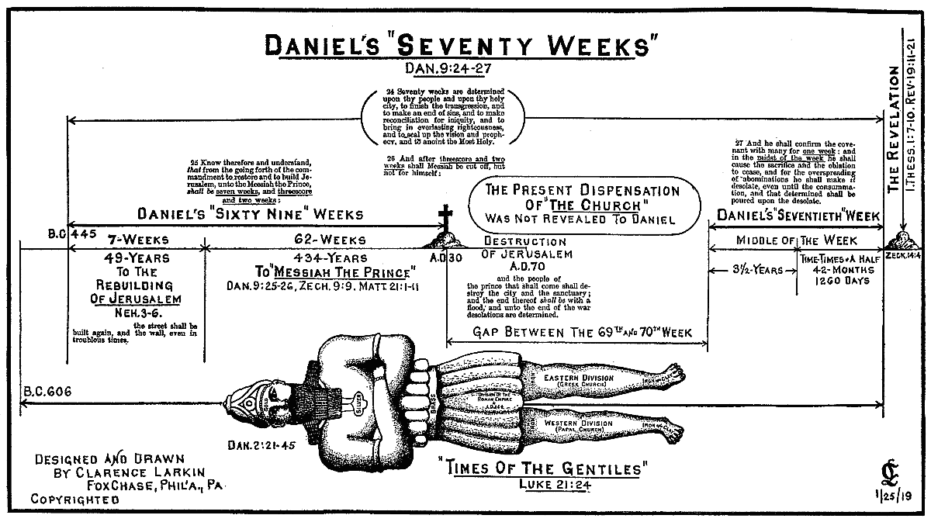
Daniel and His Peoples Future (7-12)

Slide 24
Daniel and His Peoples Future (7-12)
Everything Daniel has prophesied has dead on the entire book
And the “time of the gentiles” has been prophesied perfectly
There is no chance whatsoever that He is wrong about the last week
The Great tribulation is coming
Daniels Visitor (10)
Years later under the rule of Cyrus Daniel receives a vision of Gabriel the angel and the Lord himself

Slide 25
Daniel and His Peoples Future (7-12)
The Course of the Future (11)
“we often speak of the silent years between Malachi and Matthew. What happened in these years was written out in detail beforehand by Daniel in this chapter, which has to be one of the most amazing in the entire Bible.”
2 parts: first 35 verses deal with events that lead up to the coming of Antiochus; the last 10 deal with the coming of the antichrist

Slide 26
Daniel and His Peoples Future (7-12)
The coming of the typical Antichrist (11:1-35)
The verses so closely mirror the history at the time covered by the Apocrypha its amazing
READ 426
Our Bible is amazing
That history culminated with a man name Antiochus Epiphanes detailed in verses 21-35
“He is one of the greatest types of the Antichrist in the Scriptures”

Slide 27
Daniel and His Peoples Future (7-12)
“His hatred of the Jews, his setting up in the temple the “abomination of desolation”, and his diabolical persecution of the Jews all foreshadow the coming Beast”
The coming of the true Antichrist (11:36-45)
The prophecy once again leaps centuries in the future to the coming of the antichrist

Slide 28
Daniel and His Peoples Future (7-12)
(Dan 11:36) And the king shall do according to his will; and he shall exalt himself, and magnify himself above every god, and shall speak marvellous things against the God of gods, and shall prosper till the indignation be accomplished: for that that is determined shall be done.
And he will magnify himself above the gods of this world
But it will not last for long

Slide 29
Daniel and His Peoples Future (7-12)
(Dan 11:45) And he shall plant the tabernacles of his palace between the seas in the glorious holy mountain; yet he shall come to his end, and none shall help him.
The climax of the Future (12)
Another chapter dealing with the tribulation
(Dan 12:1) And at that time shall Michael stand up, the great prince which standeth for the children of thy people: and there shall be a time of trouble, such as never was since there was a nation even to that same time: and at that time thy people shall be delivered, every one that shall be found written in the book.

Slide 30
Daniel and His Peoples Future (7-12)
“He who weighs the dust in the balance, who numbers the hair of our head,, who counts the star, and who numbered our days has not lost control of the world’s affairs- no, not for a single day. The days are counted and controlled. Each day that passes brings us closer to that grand and glorious consummation when the kingdoms of this earth shall become the kingdom of God and His Christ”

Slide 31
Daniel and His Peoples Future (7-12)
Jesus is coming back real soon
You better be ready
All prophecy has been fulfilled and we are just waiting for the 70th weeks to start
And when it happens it will be too late for any of us
It is time to soul win
It is time to serve
It is time to get saved

